Slide 1
Thinking About Pain:
Multimodal Pain Management
October 26, 2013
Sarah Derman, RN, MSN
Clinical Nurse Specialist: Pain Management
Fraser Health: Surgical Program

Slide 2
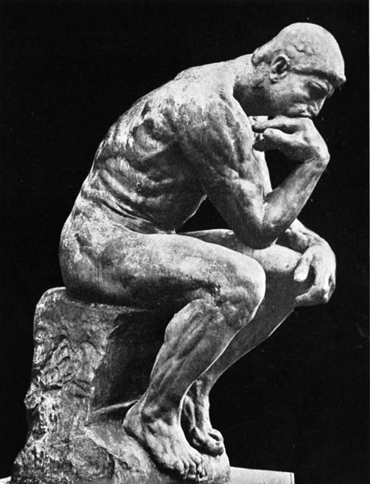

Slide 3
The amount of tissue trauma is an indicator of how much pain a patient will have.

Slide 4
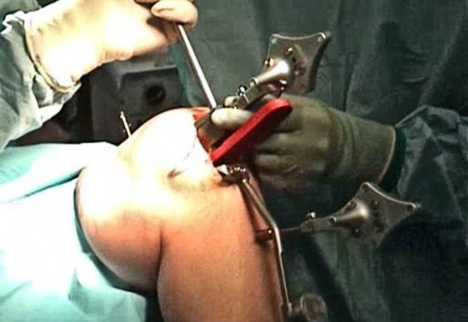
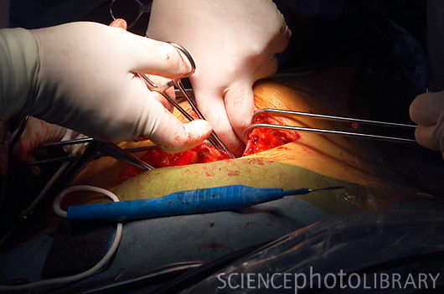
Which surgery results in more pain?
Total Knee Replacement?
Bowel Surgery?

Slide 5
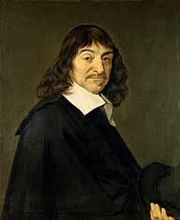
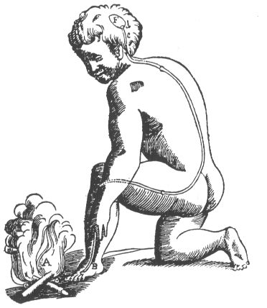
"Fast moving particles of fire ..the disturbance passes along the nerve filament until it reaches the brain..." Descartes (1664)

Slide 6
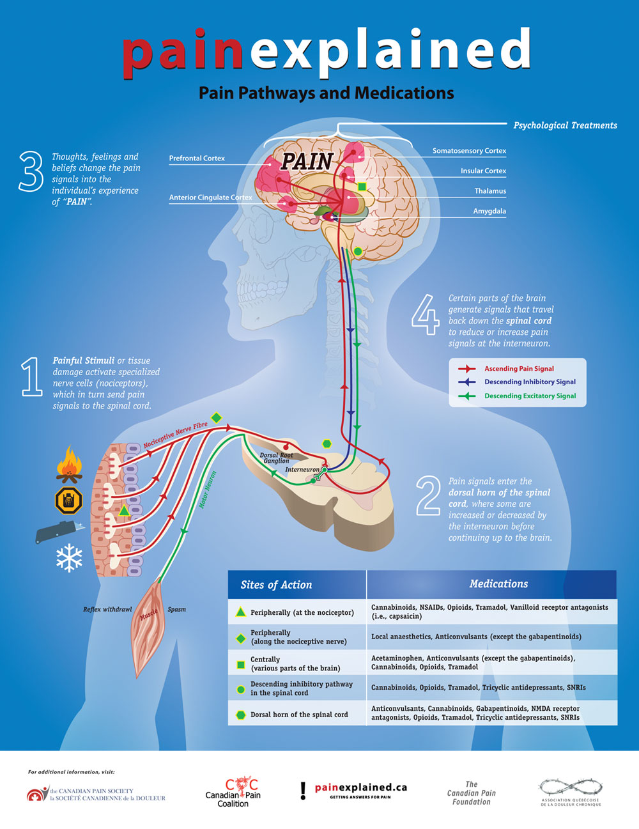

Slide 7
"Fast moving particles of fire ..the disturbance passes along the nerve filament until it reaches the brain..." Descartes (1664)

Slide 8


Pain Perception and Experience
Genetics
Co-morbidities
Chronic pain, hepatic, renal function
Other medications
Demographics
Age, Gender, Ethnicity
Emotional
Anxiety, mood, catastrophizing,
Beliefs, Values, goals
Previous experiences
Tissue damage
Nerve involvement Invasiveness of surgery
SOCIAL
Family, social situation, culture
8
Notes:
8
8

Slide 9
Genetic Variability and Pain
Pain Pathway / processing
  Ion channels
  Neurotransmitter metabolism
Drug metabolisim
  CYP2D6
Endogenous opioid production
Notes:
Pain Pathway/ processing
-ion channels involved in pain transmission (sodium, potassiuma and calcium gated channels) – different genetic variants ---
increased chronic pain, increased sensitivity to experimental pain, and increased chronic post surgical pain
-neurotrasnmitter metabolism – involved in ability to modulate or turn down our own pain signals (serotonin, norepinephrin)
-linked to increased post surgicla pin, and incicende of chronic pain – discovered another variant that may be protective
Drug metabolism –
-major drug metabolism is through Cytochrome P450 family –
One particular enzyme CYP2D6 aware of variance because that affects many opioid metabolism – particularly codeine –
4 groups – poor, intermediate metabolizers, extensive and ultra rapid metabolizers
- one study found that in the 4 hour post operative phase ultra rapid metabolizers required less morphine compared to the rest.

Slide 10
Associated Physiological Changes in Pain Management of the Elderly
Pharmacokinetics (absorption, distribution, duration & excretion) changes:
Decrease in renal function, ↓ GFR
Decrease liver function
Decrease in gastric emptying
Decrease protein levels - protein bound drugs will have higher serum levels
Less muscle and more fat – lipid soluble medications have longer half life
Meds stay in system longer, metabolites build up
Notes:
Some pharmacological considerations with the elderly.
The general start low and go slow holds well for most analgesic medications and use in the elderly.

Slide 11
Acute on Chronic
  Changes occur in the CNS with repeated pain stimuli:
  Rewiring of brain (neural plasticity)
  NMDA (N-methyl-D-asparate) involvement
  TAKES less to send a pain signal, things not normally painful can cause pain signal and things mildly painful can cause ++pain
Notes:
(more of the brain involved, more nerves involved)
(more messages faster!)
anges to the CNS and PNS “pain” pathway
Sprouting of new sensory nerve terminals in the spinal cord
Changes in local ion channels (calcium, potassium) decreasing threshold of 2nd order neurons.

Slide 12



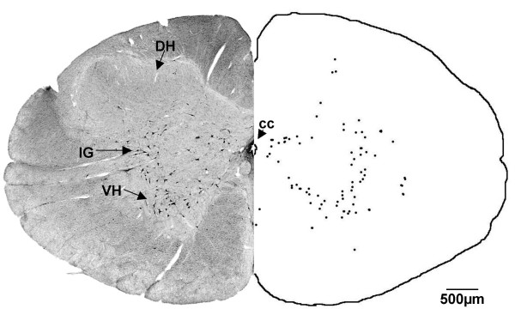
Impulse is translated into experience of pain.
Affected by thoughts, beliefs, sleep, mood, fear, anxiety
Pain Pathway
PERCEPTION
TRANSMISSION
MODULATION
Tissue damage
Spinal
Inflammatory Process (released prostaglandins, substance P)
Impulse travels along neuron axon to spinal cord (dorsal horn) then up spinal cord to the brain.
cord
TRANSDUCTION
Nociceptors translate tissue damage (heat, chemical, mechanical) into impulse.
Dorsal Horn
Descending pathway that inhibits or decreases pain impulse (endogenous opioids, noradrenalin pathway.)
Notes:
Picture to show that pain is a process – quick reminder of basic physiology, and that the red shows the various parts of the pain pathway where the different medications/ techniques will impact the pain pathway. Visual depiction of slides 5, 6, and 7.

Slide 13
Impulse is translated into experience of pain.
Affected by thoughts, beliefs, sleep, mood, fear, anxiety
Pain Pathway
PERCEPTION
TRANSMISSION
MODULATION
Tissue damage
Spinal
Inflammatory Process (released prostaglandins, substance P)
Impulse travels along neuron axon to spinal cord (dorsal horn) then up spinal cord to the brain.
cord
TRANSDUCTION
Nociceptors translate tissue damage (heat, chemical, mechanical) into impulse.
Dorsal Horn
Descending pathway that inhibits or decreases pain impulse (endogenous opioids, noradrenalin pathway.)
Notes:
Picture to show that pain is a process – quick reminder of basic physiology, and that the red shows the various parts of the pain pathway where the different medications/ techniques will impact the pain pathway. Visual depiction of slides 5, 6, and 7.

Slide 14
Changes with Chronic Pain
Substance P
Glutamate
Glutamate
Substance P
Glutamate
Glutamate
Magnesium
AMPA receptor
NMDA Receptor
AMPA
receptor
Notes:
High light that this is a symplistic visual depiction of one very small change that occurrs--- at the dorsal horn in the spinal cord. 1st order neuron brings the signals and has various neurotransmitters that are beign sent across to the second order neuron (neurtransmitters such as glutamate and substance P) – these cross the synapse and typically bidn to the various ampa receptors (multiple) and the signal continues onto the brain. There is another receptor, the NMDA receptor that is normally blocked by a magnesium plug. With repeated stimuli, this plug can get knowced out and now there is a new chanell to allow increasing signals to the brain. (we will discuss this, but this is where NMDA receptor antagonists (ketamine) work.
Interestingly this is also potentially part of the development of opioid tolerance – so it is found that with repeated opioid dosing there is actually an affect on the glutamate and it then becomes more effective atthe NMDA receptor level.

Slide 15
PAIN PERCEPTION AND EXPERIENCE
What about marijuana use?
Genetics
What about methadone?
Co-morbidities
Chronic pain, hepatic, renal function
Other medications
Demographics
Age, Gender, Ethnicity
Emotional
Anxiety, mood, catastrophizing,
Beliefs, Values, goals
Previous experiences
What about addiction?
Tissue damage
Nerve involvement Invasiveness of surgery
SOCIAL
Family, social situation, culture
What about opioid abuse?
15
Notes:
15
What
15

Slide 16
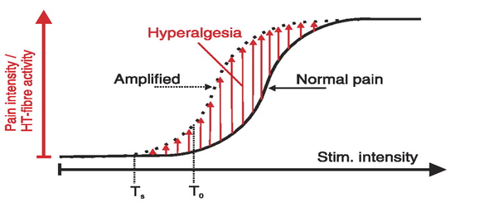
Addiction and Pain
Tolerance
Opioid Hyperalgesia?
Notes:
-Tolerance --- needing more of the drug to get increased effects– adaption, also some level of glutamernergic effect leading to increased nmda action
Some argument that this can or does lead to opioid hyperalgesia --- basically enhanced pain response to something normally painful ---– increasing opioid doses – increasing pain --- variable opinions on this, controversial, really no t great evidence and not always clear what to do with this and how to differentiate the two.
Methadoen maintenance – hyperaglgesic – meaning that rate painful things as much more painful and have lower tolerance to cold pressor – basicallly take those on Methadone and controls and put their hands into cold water – when did they first rate the experience as painful and then how long could they last before they had to withdraw their hand. And MMT rated experience painful much sooner, and more painful and had to pull hand out sooner – similar results with other bupenorphine maintence and morphine
Why – not well understood seems to have multiple parts/ causes
Tolrance is believed to be caused by changes in receptor regulation, desensitzation, and glutaminergic activation, and many other complex processes
Goals of care – prevent withdrawl, manage pain

Slide 17
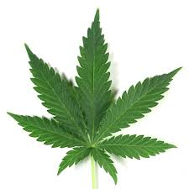
What about marijuana use?
Endocannibinoid system
Notes:
Marijuanna – THC and cannibidiol - best known chemicals with analgesic properties.
-partial agonism of cannbainoid receptors – in additon to analgesia – also shown to have muscle relaxation, some anit-inflammatory effects and possible neuropreotection in ischemia.
-act on both ascending and descending pain pathways ---- mechanism of action on just beginning to be understood – with the discovery of the endogenous cannabinoid system (or endocanibinoid system)
-involved in regulating neuronal excitability,inflammation and pain, --- other areas also, including memory, appetite, movement, etc ---still new areas of research
In the endocannabinoid system there are receptors – CB1 and 2 idnetifed but likely others – in neural tissue when activated they supress the neuronal Ca2+ conductions ---- stabilize neuronal activity
What is interesting is that the CB1 receptor is highly expressed receptor in the brain == 10 X more prevalent in the CNS compared the to mu opioid receptor, == receptors through out – interesting lower receptor expression in preain stem === argued as to why less/ no respiratory effect.
Marinol, Nabilone, sativex ---
Effect on acute pain?

Slide 18

Notes:
So huge variability in pain experience and also in how the drugs are metabolized and we respond to them – summarize and highlight the variability
So what do we do about it … how do we manage.

Slide 19
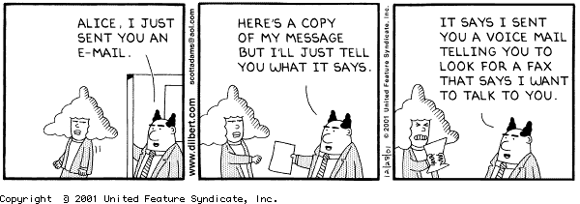
Multimodal Pain Management
Notes:
Key and central to all acute pain management is Multimodal pain management – we know this
We typically talk about acetaminophen, opioids, and NSAIds (if appropriate) may also mean nerve blocks, spinals, epidurals … so looking at different ways of interferring with the pain pathways

Slide 20
Multi Modal - Balanced Pain Management
Increases pain relief and decreases side effects
Additive pain management or Synergistic pain management
Focus on non-opioids around the clock (regularly)
Outcomes:
Reduction in PONV, and sedation
Increased early mobilization
Earlier recovery of bowel function
Notes:
Quick overview for review-- And we know the benefits.

Slide 21
Ketamine
NMDA (N-Methyl D-Aspartate) receptor agonist
Low Dose
  Introperatively
  Post operatively
Opioid sparing
Notes:
Low dose for analgesic effects – higher doses are for dissociative anaesthetic – so much lower dose
Use for pain – patient should be able to stay awake and be responsive – not anaesthetic dosing! No respiratory affect, doesn’t depress cardiac funcction or bowel function. Very fast onset
And short duration – not great orally
Beneficial for giving intra operatively and post operatively
Dosing is tyypically 0.1mg/ kg / hour (usually 5-10mg/ hr == up to max of 20mg/ hr)
Biggest problem is the hallucinations or remergence effect – need to have midazolam available / ativan
Seems to have an opioid sparing affect -- so quite useful for people on large opioid doses -- decreases or reduces tolerance – much lower opioid doses
3 known NMDA receptor agonists --- Methadone, Ketamine and Dextromthorephan
Psychotomimetic effects (titrate slowly and coadmin- ister a benzodiazepine to reduce or avoid these effects)
Hypotension
Excessive sedation
Nausea, vomiting
Excessive salivation
Apnea (with rapid IV administration)

Slide 22
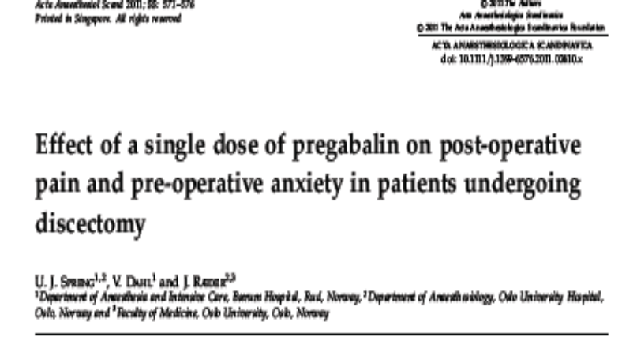
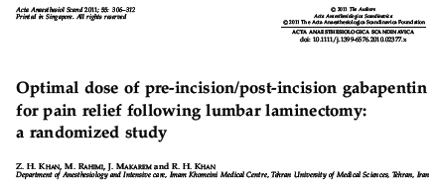
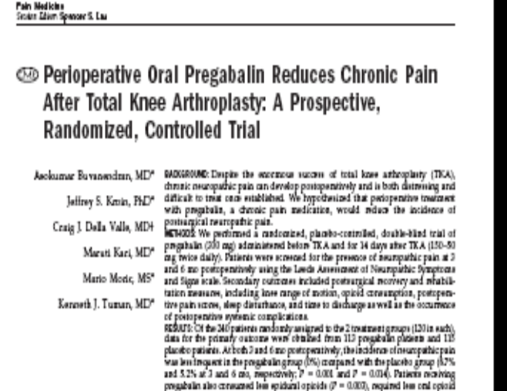
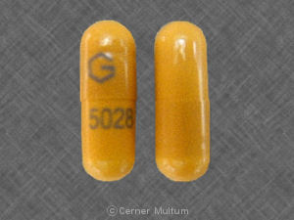
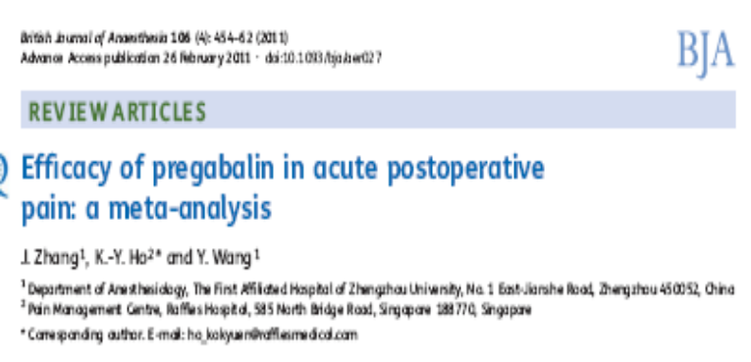
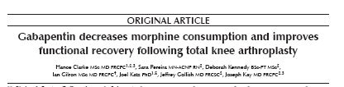
Gabapentin/ Pregabalin
Notes:
Many studies looking at the role of gabapentin or pregabalin in the use for preventative pain management post surgery. The questions are basiclly could adding either of these drugs decrease post op pain, decrease post op opiod consumption, decrease side effects and potentially decrease chronic post surgical pain.
Ultimately there is no consensus. The studies vary in quality, multiple different doses, durations of treatment and regimens are explored. Some studies look at 1 pre op dose, others examine 1 dose pre op followed by 2 weeks post. So really not clear ideal dose, or duration.
Agreement has been that there seems to be benefit of gabpentin or pregabalin, however long term benefit and dosing is still debated. Having said that both Brenda and I clinically will add pregabalin – better absorption to a complex/ challenging pain management case – with fairly good effect – sometimes it seems to be the antianxiety effect and improved sleep that helps the most. But currently it isn’t on ourr standard approach

Slide 23
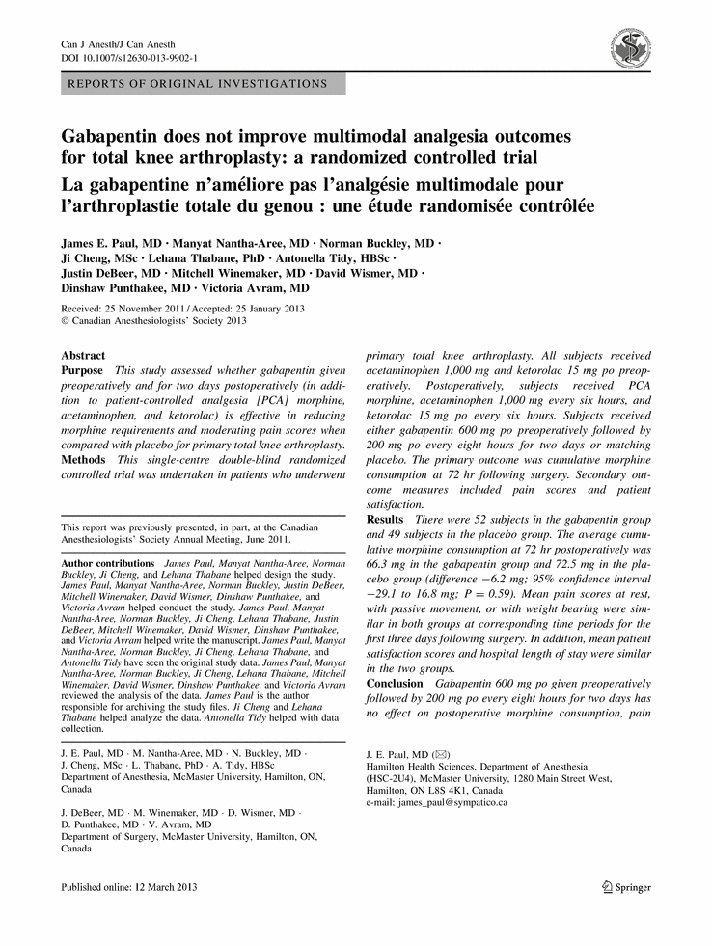

Gabapentin/ Pregabalin
Notes:
23
Recent just came out Canadian – March 2013 – RCT of 100 TKA – compared pre op 600mg Gabapentin and 2 days of 800mg/day to placebo – pca morphine, acetaminophen (paracetamol), NSAID. - spinal
Looking at opiod consuption total for 72 hours, pain scores and patient satisfaction and they found no difference.
Pre gabalin – gabapentin --- better bioavailabiilty and plasma concentration increases linearly with increasing dosee, more rapid absorption.

Slide 24
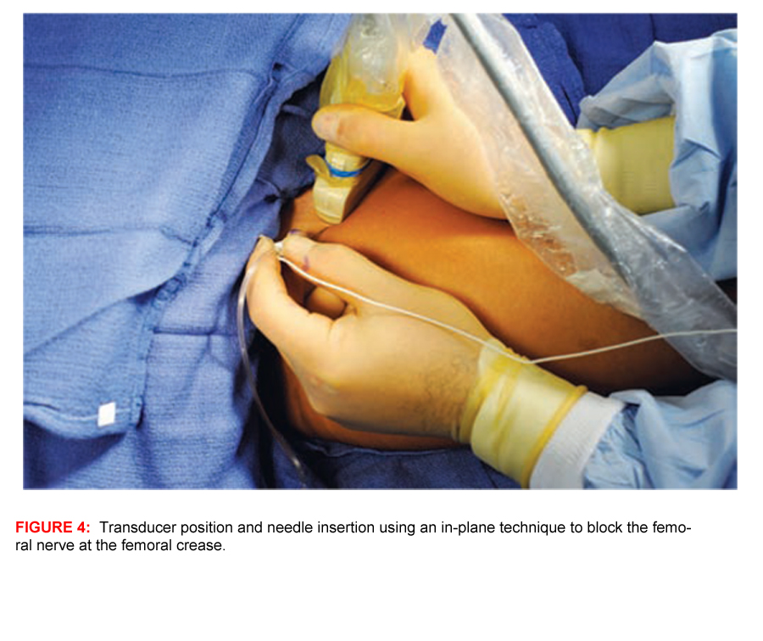
Local anaesthetic
Intrathecal
Epidural
Nerve blocks
Intra-articular local Anesthetic bolus
Notes:
Otten, Dunn, 2011 – chart review of 250 -- patients who got all 3 (morphine spinal, single shot femoral and wound catheter infusion) significantly better pain control and less opioids --- compared all 3 and combo – combo much better, -- all groups got morphine spinal --- lowest need for supplementary opioids was all 3. Next was FNB and spinal, wound and spinal followed by spinal only,.
Femoral nerve block – single and continuous – shown less pain, decresed opioid consumption and less PONV
Intra-articular bolus dose of L/A + epinepherine +/- ketorolac +/- morphine – improve pain scores, reduce opioid consumption, and facilitate functional recovery – recent study looking at compression dressing x 48 hours to prolong effect
Intrarticular block – high volume injection around the joint – typically ropivacaine, but can have mix of other solutions – some use opioids, ketamine, clonicdine - provide significant pain relief – many areas have started using compression dressings to slow the systemic absorption and spread of the local anaesthetic and extend the block – some evidence of up to 48 hours, although typicaly is closer to the 24 hour mark.

Slide 25
Lidocaine Intravenously
Low dose infusion introperatively
Outcomes
  Lower rates of illeus post abdominal surgery
  Improved pain control
  Less opioid use
Challenges
  ? Evidence (small studies)
  Local anaesthetic toxicity?
Notes:
Shortened hospital stays, earlier bowel recovery, improved pain control
Challenges – many of the studies are small, not great quality and some concern about local anaesthetic toxicity – so are the dosing too high.
However there are small areas using this and seem to have benefit.
Some areas even are using Lidocaine running into PACU, and post operatively === issues around monitoring and safety, b

Slide 26
All Chronic Pain Started as Acute Pain.

Slide 27

Notes:
Looking at the bigger picture – reminder about why we do what we do --- caring for our patients
And reminder that what you do in the PACU for pain management is incredibly important – not only at that momement, or even for the rest of their hospital stay, but also for the rehab, and recovery and potentially even months to years after surgery.

Slide 28
“Multiple studies have consistently found a
strong correlation between the severity of acute
postoperative pain and the development of
persistent postsurgical pain”
(IASP, 2011).
Notes:
Final reminder that what is done in PACU matters,

