Slide 1
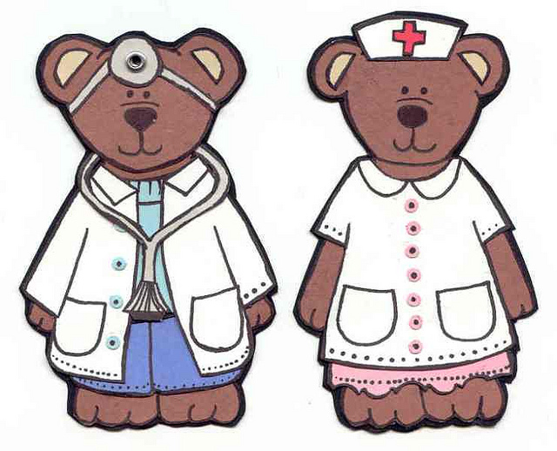
Has This ever Happened to You?
Well, it is 2 am, give some fluids and call me in the morning
Hi Dr.
I am sorry to bother you, but your patient Mr. X is deteriorating and I need some help

Slide 2
Purpose on New PEAS CPG
The purpose of this new protocol is to provide
Post Anesthetic Care Unit (PACU) nurses with critical language that is clear, concise and cannot be misinterpreted to communicate the clinical needs of a deteriorating patient to the MRP. (Most Responsible Physician)

Slide 3
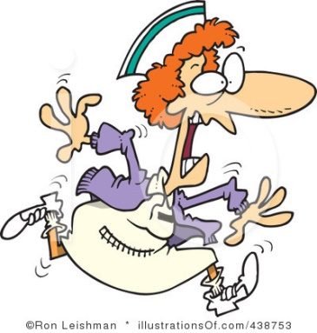
PeriAnesthesia Escalation and Acuity Scale (PEAS)
PEAS is a scale that identifies patient acuity and provides guidelines that defines a maximum recommended time within which a physician should assess the patient and direct care.
PEAS, Please Help Us Now!

Slide 4
PEAS
PEAS Level 1 – Patient needs to be assessed by a physician immediately.
PEAS Level 2 – Patient needs to be assessed by a physician within 30-45 minutes

Slide 5

The PACU RN will communicate clearly and concisely the need for escalation of care by using The PEAS framework
PEAS levels cannot be misinterpreted when stated and documented

Slide 6

Outcome
Escalation of care for patients exhibiting signs of deterioration will occur at the earliest point possible and continue until the patient receives the appropriate care in the appropriate environment and by the appropriate care provider

