Slide 1


Slide 2

Strategies and Tools to deal with transformative change at a personal, team and patient level.
PAN BC 2022 Annual AGM and Education Day April 30, 2022 Conference Theme: Resilience
Notes:
In the past 20 months,
How many of you dealt with covid patients?
Moved around to different areas?
Stayed in a hotel or away from family and friends?
Overtime?
Shut down elective surgeries?
Created or involved in some kind of surgical initiative?
Overwelmed?
Exhausted?
Felt like you couldn’t get through it?
Failed in what you were doing?
Felt that you had to choose between helping the patient or your self care
You are all here today so you were successful in getting through it, however that looked for you.
What have you done and can you let go of to move ?
What did you learn about yourself – as this was no accident
What is important to you at this time?
This video is for you….

Slide 3
Learning Objectives
Clarity on how you deal with transformative change at a personal level and what you learned about yourself.
Connect with colleagues to share tools and strategies that got you through the past 20 months.
Understand the psychological process of what actually happens in transformation and how you, your team and patients can move though with awareness.

Slide 4

Notes:
https://www.youtube.com/watch?v=jwjGw3BCryI (to 7min)

Slide 5

1.Working at your tables, one at a time, say your name and where you work.
2. Answer the question without responding to anyone else’s comments.
In the past 20 months,
What did you learn about yourself and what is important for you at this time?
Notes:
How many of your were so frustrated and angry and felt guilty because you are nurses and had to do self care. There is no accident you went though all you went though the past 20 min. Reflecting on what you did, the hardships, the tears, the almost giving up.
Take a few minutes to think about what can you let go of? You were successful in getting though it. In the video, it talks about “everyone is looking for a transformation without being inconvenience of being uncomfortable”
What did you learn about yourself and what is important to you at this time ? ( at your tables, one at a time, say your name, where you work and answer the question). I will give you 15 min or at your tables.
Two rotations of 15min….

Slide 6
Transitional Change
Transition State
New State
Old State
Source: Ackerman and Ackerman Anderson (2001)
Notes:
Speak: Transitional Change is the design and implementation of a new state. This requires dismantling of the old state and management of the transition process in between. Transitional changes replace what exists with something entirely different.
Examples: Technological advancements that replace an existing process but not the behaviour i.e.: electronic vs. paper charting. The impact is significant – but the end state was known and clearly articulated; the old state needed to be changed, and there was a specific timeline and plan for the path forward.

Slide 7

Transformational Change
Success Plateau
Re‐Emergence Through Visioning and Learning
Wake‐Up Calls
Growth
Chaos
Birth
Death: Mindset Forced to Shift
Source: Ackerman and Ackerman Anderson (2001)
Notes:
In Transformational Change, the old state and worldview are forced to die. The new state is unknown. It emerges from visioning, trial and error, and learning. The new state requires a radical shift in mindset, organizing principles, behaviour and culture. A critical mass must operate from a new mindset and new behaviour for the transformation to succeed.
Other examples: Electricity, the web, 3D printing
Ask: In order to get to our new reality, what mind shifts are necessary to transform us into this future state? What deaths are necessary?
What mindsets are necessary to actually transform us into the new reality? What mindsets have to go away? (pairs/groups)

Slide 8
Personal Awareness of Change
ENDINGS
EXPLORATION
NEW BEGINNINGS
+
Denial
Enthusiasm
Anxiety
Energy
Shock
Hope
Morale
Fear
Impatience
Productivity
Anger
Acceptance
Frustration
Creativity
-
Confusion
Scepticism
Stress
Avoidance
Source: Bridges Model
Notes:
Individually
Identify where you were on the curve. What was that like for you?
What tools and techniques did you use to move through it?
ENDING: People enter this initial stage of transition when they are first presented with change. This stage is often marked with resistance and emotional upheaval because people are being forced to let go of something they are comfortable with.
TRANSITION (or the Neutral Zone): In this stage, people affected by the change are often confused, uncertain, and impatient. Depending on how well the change is being managed, they may also experience a higher workload as they get used to new systems and new ways of working. Think of this phase as the bridge between the old and the new; in some ways, people will still be attached to the old, while also trying to adapt to the new.
BEGINNING: The last transition stage is a time of acceptance and energy. People have begun to embrace the change initiative. They're building the skills they need to work successfully in the new way, and they're starting to see early wins from their efforts.

Slide 9
Common Experiences in Each Phase
Endings
Neutral Zone
Resentment towards the change initiative
New Beginnings
High energy
Low morale and low productivity
Anxiety about their role, status or identity
Skepticism about the change initiative
Openness to learning
Renewed commitment to the group or their role
A sense of loss
Uncertainty
Frustration
Disorientation
Sadness
Anger
Denial
Fear

Slide 10

At your current tables:
Describe clearly and specifically:
“How did you move through the change and emotional triggers …successfully? “
2.” What is one thing you would do differently next time?”
Notes:
How to prepare, what steps can they take if this happens again? Share information with each other…. Policies changed.. frustrating in prog practice policy would change daily. `20 min
How do you move through the triggers…. ( ind) how did you handlde,, and what you could do.
45 min..
Change curve..
How did you manage emotions and how did you? 30 min
Coaching question:
If you can’t change any ext

Slide 11
Personal Awareness of Change
ENDINGS
EXPLORATION
NEW BEGINNINGS
+
Be Empathetic
Celebrate Success
Mark the Ending
Build Alliances
Acknowledge Losses
Discuss the New Future
Morale
Reinforce need for Change
Productivity
Challenge to Take Action
Share Information
Provide Training
Provide Structure
Define Roles & Responsibilities
Celebrate Progress
Encourage Personal Responsibility
-
Ensure Meaningful Work
Be Approachable
Source: Bridges Model
Notes:
Duration: 5-7 minutes
Speak: Leaders and colleagues need to provide different levels of support at each stage of the curve. Briefly outline the support required at each stage of the change curve. Following on from the example used for the previous slide, continue the story and highlight what support was required at the relevant stages of the change curve. This example is preparing the leaders to think about how they can provide support to their team, again
.
Ask: Participants to open their workbooks to page 4 and using the stage in the curve they identified that they and their team are at (on page 3), what level of support is required. Ask the participants to break into groups of 2-3 and brainstorm how they can provide that support to their team.
(i.e. what form will that support take? E.g. if ‘provide training’ was highlighted – to whom, about what, by when?)

Slide 12
How You Can Provide Support
Hold Space
For whatever comes up – feelings or emotions. Hold space without judgment.
Acknowledge Them
Provide them with an acknowledgement of who they are as a person, their work and efforts, and ask how you can support them.
Match Them
Give Them Space
Ask Permission
Engage Them
Match their energy and body language (fast paced, slower paced).Write down what they said, read it back and ask if there is anything else.
Allow them to go through whatever they are going through. Things might be coming up for them from the past – this is a gift.
Ask them whether they are open to questions.
If you’re offering suggestions or advice, ask if they are open to it.
Engage them at eye level so they feel seen and heard without responding.
Notes:
Duration: 2-4 minutes
Speak: Explain that once you have noticed that there are some signs that indicate that someone may need support and that these are significantly differently from usual, they can provide support to their team by initiating a conversation with the person. Highlight that they can use the skills they have learnt in coaching and providing feedback to help them prepare and initiate the conversation. Explain that this is a checklist of things to keep in mind when preparing for the discussion and when having the conversation with the person. Talk through each point and refer them to page 7 in their toolkit for this checklist. When you get to the “discuss possible solutions” point, talk about action planning and setting a goal moving forward. Engage the person in that process and understand what will work best for that person. When arranging for a follow-up meeting to check on progress, this may be a place to review the person’s progress.
This is a good checklist and also a nice summary of what we have covered in the session today.
Check for understanding of any concepts that haven’t been covered (such as active listening)
Hold space for them - for whatever comes up - feelings, emotions. Let them feel you are beside them in this without judgement
Acknowledge them “Can I start off by saying I really see how brilliant you as a surgeon and how caring you are towards your patients. And I get how frustrating this is for you” How can I support you in this?
Match their energy and body language (fast paced, slower paced) Write down exactly what they said so they can see it and read it back to see if you missed anything. Then ask is there anything else
Let them go through whatever they are going through. This is a gift. Something might be coming up from the past to be released.
Ask if they are open to a question? I notice you have said frustrated 3 times, what ‘s going on for you? What this like for you? What is the impact on your patients, your day, your work? I can see how important this is to you. What and how can I support you? And then listen.
Engage at eye level so they feel seen and heard without responding
Ask if they are open to something that popped for you? Always get permission!! If yes, you can share a brief of story and say this may or may not land for you but when I was going through this …. What worked for me was …… What do you make of that?
Venting:
If not venting, where would you want them to go? “Solution focused discussion?”
“Exploration /optimism” (inside/outside control)
Reflection: from this conversation, what supports work for you?

Slide 13
Additional tools for you, your team and patients to move through transformation

Slide 14



Coping Model – Stephen Covey
Control
Proactive
Influence
Concern
Reactive
Notes:
This is all about where you spend your energy
Though we can’t increase the number of things we control, a proactive perspective can expand our circle of influence – whereas a reactive frame of mind beings to encroach on our circle of influence – limiting the amount of things we believe we can influence.

Slide 15
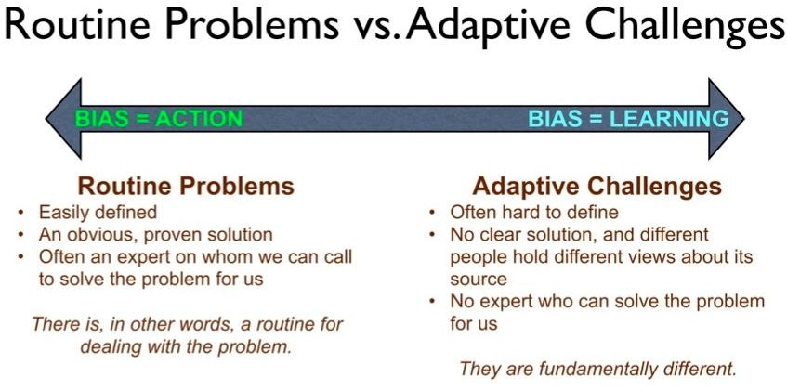
Notes:
As a change leader, one area you have to play in is dealing with routine problems vs Adaptive challenges
Planned: One of the biggest distinctions about change is in relation to the nature of change.
IF you think of change as being moving from one state to another in a structured manner, you are more likely to develop models which highlight a structured set of steps. This is generally referred to as “planned change”.
When things go sideways:
Be curious? What is happening?
What am I noticing?
What can I find out?

Slide 16
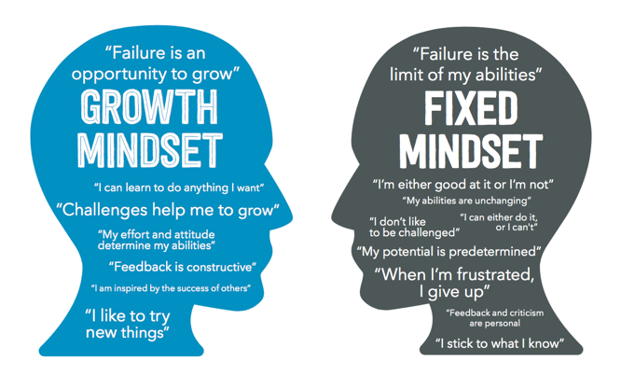
Fixed vs Adaptive Mindset
Notes:
Your life as a change leader is dealing with things that go sideways. How you perceive your reality will be a very powerful force in determining your outcomes.

Slide 17
Managing Energy Levels
At Work
At Home
Energy
Boosters
Energy
Drainers
Notes:
Move to one of four stations
Duration: 2 minutes
Speak: Explain that there is further detail on how to manage energy levels, as well as a homework activity in the workbook.
Facilitate discussion in the room
While this is at the forefront of your mind, jump to pg19 near the back of the workbook (in amongst other post-course work) and take a moment to consider the quadrants displayed and fill in anything that springs to mind (what does your oxygen mask look like?)
Ask: does anyo
ne have any examples they wrote down which they would be happy to share (to allow others to add to their list)

Slide 18
Managing Energy Levels
Assess our energy balance
To support self management and resilience as leaders
Identify energizers and drainers to bounce back with minimal impact on team’s functioning
To maintain a positive relationship with your team, even through hurdles, conflict and disagreements
To manage anxiety in the face of adversity
Manage complaints and turn them into opportunities
Skills to deliver under pressure
Notes:
Duration: 5 minutes
Speak: Introduce energy levels and managing these.
Ask: Ask the group, “Why is managing your energy important for them as Change Leaders and their team?”.
Do: Click to reveal potential answers. Debrief the questions by highlighting the importance of managing energy and supporting self management.
Speak: Explain that self management is any activity that you voluntarily do which helps you maintain your physical, mental or emotional health. It can help you feel healthy, relaxed and ready to take on your work and responsibilities. Refer them to the Leader’s Toolkit for additional resources on self management and resilience.

Slide 19
Top Eight Reasons Change Fails
Failure | Description
1 | Leaders aren’t being clear on “why we need to change” so it is compelling and shakes people out of complacency.
2 | Leaders haven’t communicated “what the world will look like when we have changed” in a way that makes it attractive enough so people will want to go there.
3 | Leaders haven’t communicated the “practical and doable steps that will get us there” so it makes sense and gives people confidence that the leaders know what they are doing.
4 | Leaders themselves are not demonstrating support for the change, so people don’t feel they need to either.
5 | Leaders don’t change themselves; the way they do things, the things they say. It’s called “walking the talk”. That means that the culture doesn’t change.
6 | Communication is poor, non-existent, or once-off.
7 | Employees are not involved; the change is done to them. Leaders don’t understand the impact of change on people and worse, they don’t seem to care so trust is eroded fast.
8 | The change doesn’t get bedded down because leaders turn their attention to other things too early. I call it “Leadership ADHD”.
Rosalind Cardinal. Leading Change. Turning Change Fails into Change Success. E-book

Slide 20
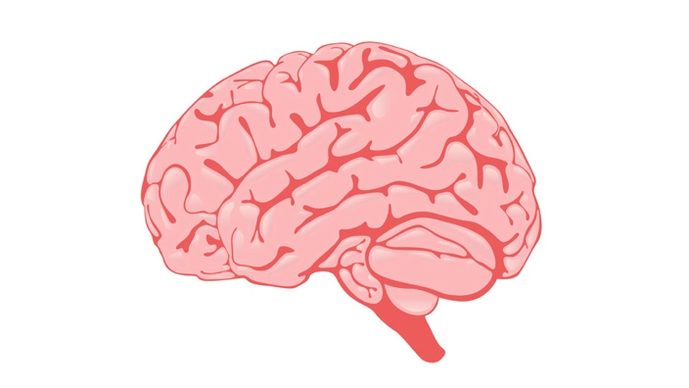
Personal Awareness of Change
Research on the brain suggests we perceive social threats and rewards
the same way we process physical threats and rewards.
When our social environment
is threatening, we react in a way that moves away from the threat (i.e. defensive, avoidant, disengaged)
When our social environment is rewarding or safe, we think more rationally, make better decisions and are more willing to move toward
our goals
Our role is to create a safe environment where employees feel they can
contribute to the conversation.
Notes:
*Touch on Shame response
Do: Ask participants to pair up with the person next to them. Ask one person to nominate themselves as ‘A’ and one as ‘B’. When you give the order, person ‘A’ will push. Give the order the observe the reaction. Nearly all of the time, you will find that the person will be met with resistance. Introduce this as a good metaphor for how our brains work.
Speak: 50,000 years ago in African savannah, when we heard a rustle in the bush the fight/flight response was engaged. That response is still present today. We also know from research on the brain that we perceive social threats and reward in the same way we process physical threats and rewards.
Do and Say: Click the mouse to activate the first animation. When our social environment is threatening, we react in a way that moves away from the threat (i.e. by becoming defensive, avoidant, being quiet, disengaged).
Click the mouse to activate the second animation. When our social environment is rewarding or safe, we feel more motivated, engaged and willing to share our thoughts, collaborate, make better decisions and are more willing to move toward our goals (engaged). Change requires more cognitive effort and our brain will prefer to get back to what is familiar as soon as possible
Click the mouse to activate the final animation. As leaders in the change process, our role is to create a safe environment where employees feel they can contribute to the conversation.
Don’t use reason when people are in threat state – until they get back into their pre-frontal cortex, they’re still in ‘amygdala hijack’ mode – similar to a patient that’s got recent news about cancer

Slide 21
Personal Awareness of Change
Status
Certainty
Autonomy
Relatedness
Fairness
AWAY
TOWARD
From Threat
Response
Reward
Response
7
Source: SCARF model, David Rock
Notes:
Let’s talk about what is going on in your brains during this change:
Have all participants do the self assessment of the SCARF model ( if they choose after class)
Mini Teaching on the model using an actual scenario from someone in class
The greater the expected loss, the greater the resistance to the change. People’s fear is based on their perception of the situation – it doesn’t matter whether their beliefs are accurate. If people sense loss they will resist the change. If they don’t have enough information to determine if the change is going to result in a loss or a gain (especially for someone else), they will resist until they have enough information to decide.
In a change, it is vital to think about the people and what they are going to lose (and also what their perceived losses will be).
Read the following statements and get the group to identify the appropriate SCARF domain:
Some of the possible losses are:
Brainstorm list of what happens when you get triggered and then match them to the 6 elements of the Scarf model
Security – no longer feeling in control, not knowing what the future holds, or where you are in the organisation .CERTAINTY
Competence – no longer feeling that you know what to do, or how to do it, new unfamiliar tasks, fear of increased workload. STATUS / AUTONOMY
Relationships – losing contact with customers, colleagues, managers – or the nature of the contact changes. Losing sense of belonging to a team, group or organisation. Loss of social networks. RELATEDNESS
Sense of direction – losing understanding of where you are going and why. CERTAINTY
Territory – physical workspace, job roles and assignments, psychological space. STATUS
Respect – feeling that your old ways of doing things are being criticised. STATUS
Expert knowledge – losing the esteem that comes from being an expert and feeling important. STATUS
Disruption of routine – loss of familiar and predictable ways of doing things. CERTAINTY
Benefits – loss of career prospects, wages and benefits, increased job demands. FAIRNESS / STATUS / AUTONOMY
Threat to position, power and security – loss of status and prestige. STATUS
Once you have identified possible losses, you need to plan for how you will deal with them. You could use emotion regulation techniques such as:
Reframe it – Involves challenging the assumption the loss will have only negative impacts. It involves focusing instead on what is positive and controllable about the situation.
Replace it – Involves looking for other ways to get what people have lost, or finding gains that outweigh the losses.
AGES: attention, generation, excitement (optimal arousal curve) & spacing

Slide 22
Thankyou!
Please feel free to reach out at
Chantalnormandcoaching@gmail.com

