Slide 1
IV LIDOCAINE INFUSION
FOR POST-OPERATIVE ANALGESIA
DR SIMON BURROWS
ANESTHESIOLOGIST
LIONS GATE HOSPITAL

Slide 2
IV Lidocaine Infusion (IVLI)
Background
Mechanism of action and effects
Indications for post-operative IVLI
How effective is IVLI?
Safety and toxicity
Administration

Slide 3
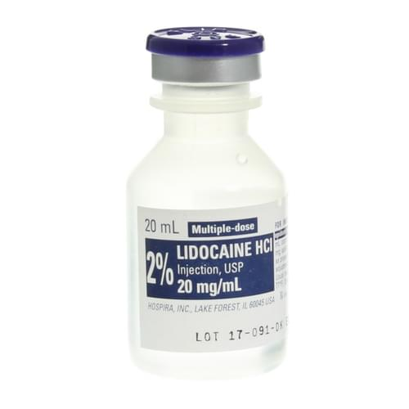
Background
  Amide local anesthetic, developed in 1940s.
  Mostly used for local infiltration and regional nerve blocks
  IV infusions used for years in chronic pain conditions
  Post-operative IV infusion emerged in last 10 years
    Low dose rates of <2mg/kg/hour for up to 24-48 hr
    Evidence for safety in monitored and unmonitored environments

Slide 4
Background
Post-op IVLI used in Canada since early 2010s (VCH since 2016)
Need for alternative post-op analgesia options
Evidence for:
Analgesic and anti-hyperalgesic effect
Reduced postop nausea
Earlier return of bowel function and mobilization
Increasing MIS surgery (bowel resections, nephrectomies etc).
Decreasing use of thoracic epidural analgesia
Anti-inflammatory effect

Slide 5
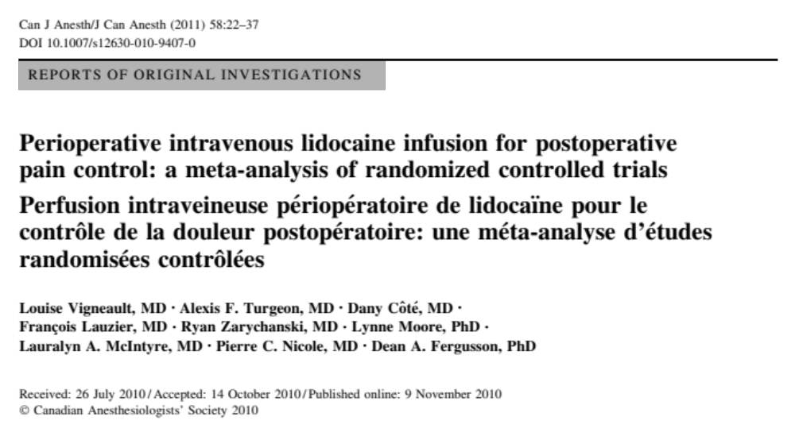
.
Notes:
WMD is weighted mean difference
Approx 10mm on 0-100mm pain VAS
Modest but statistically significant reductions in pain
Reductions in opioid dose, time to bowel function, nausea and vomiting

Slide 6
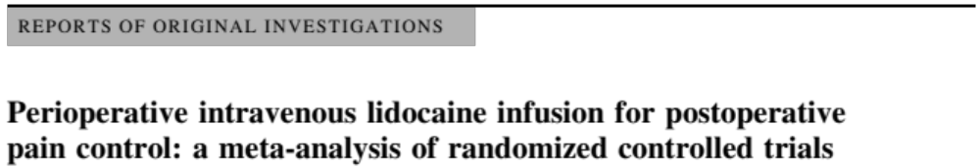
Review of 29 studies including 1,754 patients
Pain scores at six hours post-op:
  pain at rest: WMD -8.70 on 0-100 pain scale
  pain during cough: WMD -11.19 on 0-100 pain scale
  pain during movement: WMD -9.56 on 0-100 pain scale
Other outcomes:
  opioid dose: WMD -8.44 mg morphine equivalents
  time to bowel recovery: WMD -7.62 hr
  nausea/vomiting: risk ratio = 0.71
Patients having abdominal surgery showed most benefit.
Notes:
WMD is weighted mean difference
Approx 10mm on 0-100mm pain VAS
Modest but statistically significant reductions in pain
Reductions in opioid dose, time to bowel function, nausea and vomiting

Slide 7
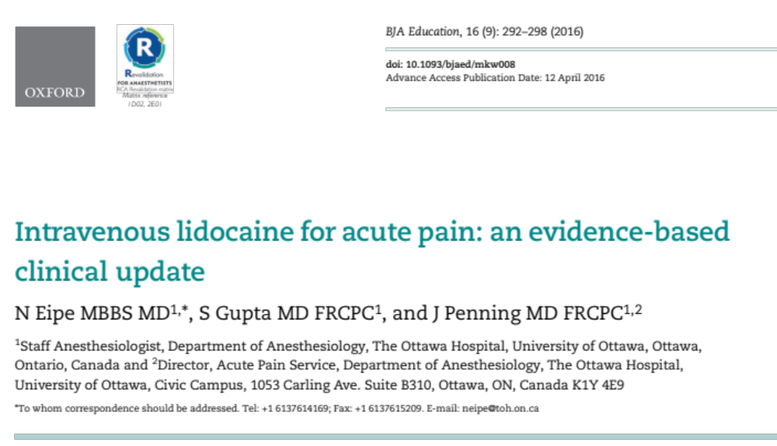
Notes:
WMD is weighted mean difference
Approx 10mm on 0-100mm pain VAS
Modest but statistically significant reductions in pain
Reductions in opioid dose, time to bowel function, nausea and vomiting

Slide 8
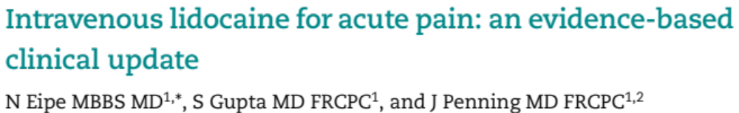
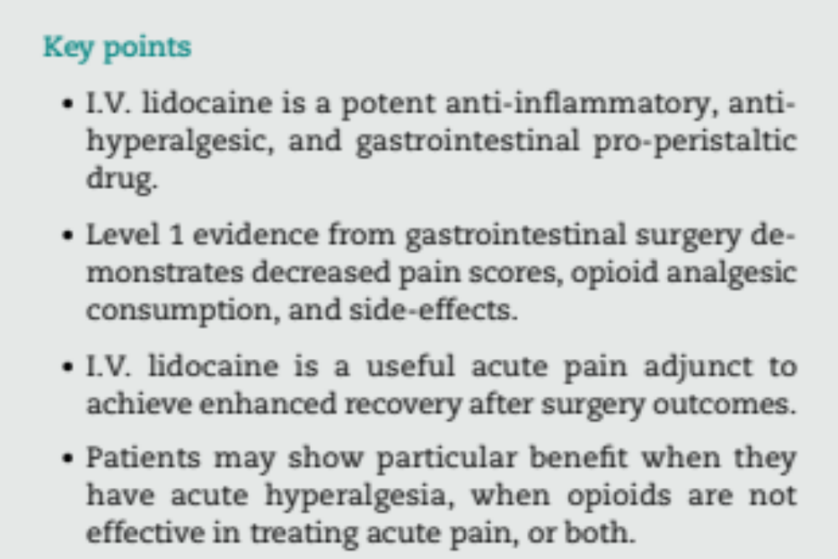
Notes:
WMD is weighted mean difference
Approx 10mm on 0-100mm pain VAS
Modest but statistically significant reductions in pain
Reductions in opioid dose, time to bowel function, nausea and vomiting

Slide 9
Mechanism of Action
Local Infiltration
Binds to sodium channels in nerve membrane, blocking nerve signal transmission
Low-dose Intravenous infusion:
Mechanism is multimodal, not well understood
Partly due to sodium channel blockade
Also has effects at multiple other receptors:
NMDA
M1 and M3 muscarinic
Serotoninergic

Slide 10
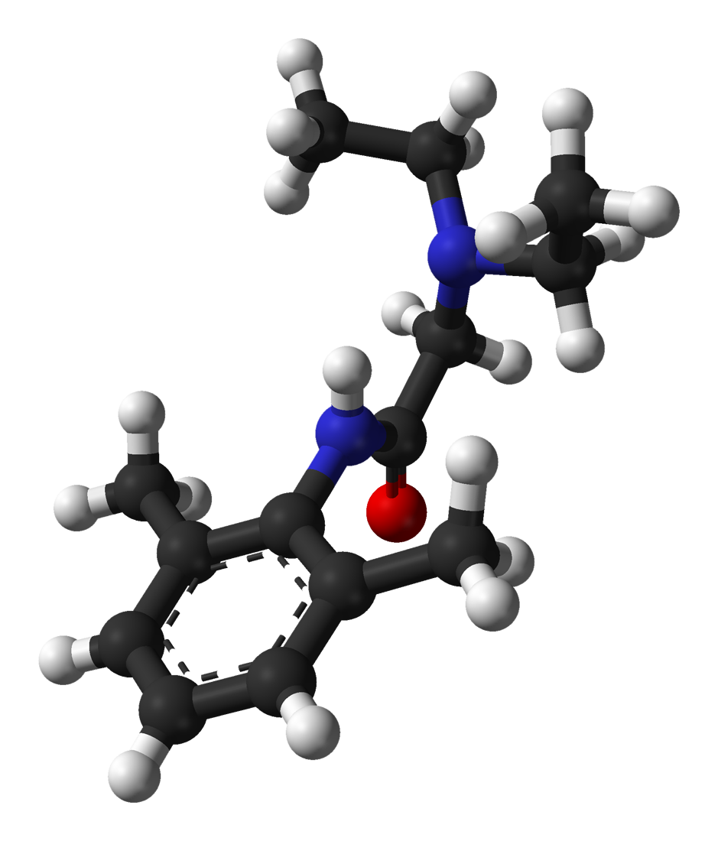
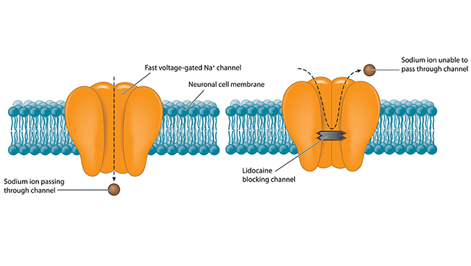
Mechanism of action

Slide 11
Effects
Analgesic (antinociceptive) effect
Especially effective for post-surgical and neuropathic pain
Anti-hyperalgesic effect:
Blocks proliferation of Na channels in traumatized nerves
Reduces central sensitization of spinal neurons (NMDA)
Possible reduced progression to chronic pain conditions
Hyperalgesia:
Abnormally increased sensitivity to painful stimuli
Increased risk for progression to chronic pain syndrome
Notes:
-Should be effective against normal post-op pain as well as abnormal hyperalgesic pain

Slide 12
Effects
Gastro-intestinal prokinetic effect
Anti-emetic effect
Anti-inflammatory effect
Reduced opioid consumption
Block of sympathetic reflexes
Reduced catecholamine production
Direct effect on gut smooth muscle
Faster bowel recovery after GI surgery (8-12 hours)
Decreased leukocyte priming
Partly due to decreased opioid use
Notes:
-Should be effective against normal post-op pain as well as abnormal hyperalgesic pain

Slide 13
Effects
Improved pain scores
Reduced opioid consumption and opioid side effects
Reduced post-op nausea and vomiting
Faster bowel recovery after abdominal surgery
Reduced inflammatory response
Some studies suggest reduced progression to neuropathic and chronic pain conditions

Slide 14
Indications
Adjuvant (similar to ketamine, gabapentinoids)
One component of a multimodal pain management plan
Usually with opioid PCA and acetaminophen for 24 hours post-op
Can use with ketamine infusion, gabapentin etc.
May have particular benefit in patients with:
GI or spinal surgery
neuropathic pain conditions
chronic pain syndromes
opioid tolerance
hyperalgesia

Slide 15
Indications
Laparoscopic or open bowel surgery
Some evidence for improved ERAS outcomes:
These benefits not seen with ketamine or gabapentinoids
Spinal surgery
High incidence of chronic pain, neuropathic pain, chronic opioid use
Farag 2013: 116 patients undergoing complex spinal surgery
IVLI 2mg/kg/hr for 8 hr post-op
At 48 hrs, pain ↓10-25%, opioid consumption ↓ 25%
Improved quality of life scores at 1 and 3 months
Earlier bowel recovery, ambulation, shorter HLOS

Slide 16
Indications
Epidural contra-indicated, declined by patient etc.
Patients with neuropathic pain:
Patients with other pre-existing chronic pain syndromes
Major surgical procedures where epidural not possible:
Limb trauma, nerve injury, amputation surgery
Neuropathic pain may co-exist with acute surgical pain post-operatively
Burning, shooting, stabbing pain, associated paresthesia, numbness

Slide 17
Indications
Patients with opioid tolerance
Patients with hyperalgesia
Abnormally increased sensitivity to painful stimuli
Increasing pain intensity, spread of pain to other locations
Opioid-induced hyperalgesia can develop acutely post-op
Increasing opioid dose may worsen pain control
Lidocaine (and ketamine) likely to act via NMDA blockade

Slide 18
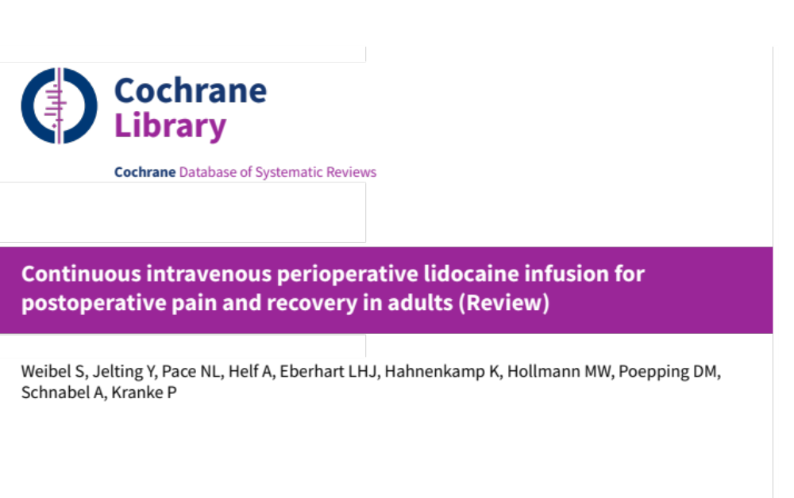

Slide 19

Largest review of IV lidocaine infusion to date (2018)
68 small RCTs with 4525 randomized participants
Open abdominal surgery: 22 trials
Laparoscopic abdominal surgery: 20 trials
Other surgery: 26 trials
Dose and duration of lidocaine infusion varied
Cochrane review: more rigorous approach to reviewing evidence
No large multi-centre randomized controlled trials exist
Evidence overall of “low quality”
Possibility of bias in many trials

Slide 20

At early time points (1-4 hours) after surgery, there was an average pain reduction of between 0.37 cm and 2.48 cm on a 0 to 10 cm visual analogue scale (SMD -0.5 cm).
We are uncertain whether IV lidocaine improves postoperative pain compared to placebo or no treatment at early time points (1 to 4 hours) after surgery, (very low-quality evidence).
Pain at 1-4 hours post-op

Slide 21
Average pain reduction of between 0.10 cm to 0.48 cm at 24 hours (SMD -0.14 cm) and 0.08 cm to 0.42 cm at 48 hours (SMD -0.11 cm).
Assuming approximately 1cm on a 0 – 10cm pain scale is clinically meaningful, we ruled out a clinically relevant reduction in pain with lidocaine at 24 hours and at 48 hours (moderate-quality evidence).
Pain at 24 and 48 hours post-op
Notes:
-Moderate quality evidence this time, more confidence in findings

Slide 22
Other outcomes:
time to bowel recovery (mean difference MD −7.92 hours)
risk of postoperative nausea (risk ratio 0.78)
opioid consumption (MD −4.52 mg morphine equivalents)
We are uncertain whether lidocaine reduces the risk of ileus, time to first bowel movement, risk of post-operative nausea, or opioid consumption.
Quality of evidence was very low for all these outcomes.

Slide 23
Authors’ conclusions:
We are uncertain whether IV perioperative lidocaine, when compared to placebo or no treatment, has a beneficial impact on pain scores in the early postoperative phase, and on gastrointestinal recovery, postoperative nausea, and opioid consumption.
Lidocaine probably has no clinically relevant effect on pain scores later than 24 hours.
The quality of evidence was limited due to inconsistency, imprecision, and study quality.

Slide 24
Safety and Toxicity
Narrow therapeutic index
  target therapeutic concentration (Cp): 2.5-3.5mcg/mL
  toxicity: 5mcg/mL and higher
Poor correlation between Cp and onset of toxicity
Patient predisposing factors are important:
  neurological conditions/epilepsy
  cardiac conduction abnormalities (HB, BBB)
  hypoxia
  electrolyte abnormalities

Slide 25
Safety and Toxicity
Infusions <3mg/kg/hr usually maintain Cp <5mcg/mL
At typical infusion rates, Cp varies between patients
Toxic concentrations are possible with typical infusion rates in some patients
Factors that can cause higher plasma concentration:
    Low albumin level
    Acidosis (increases unbound fraction)
    Low BMI (reduced skeletal muscle uptake)
    High BMI>30 (if actual body weight dosing used)
    Impaired clearance or metabolism of lidocaine

Slide 26
Safety and Toxicity
Risk of impaired lidocaine clearance in patients with:
  Cardiac failure or low cardiac output
  Hepatic failure or cirrhosis
  Advanced renal disease
  Hypotension, sepsis, shock etc.
Risk of toxicity increases with infusions >24 hours

Slide 27
Contra-indications
Patients predisposed to lidocaine toxicity:
Cardiac conduction abnormalities:
heart block, BBB, sinus bradycardia
Seizure disorders and other neurological disorders
Patients with impaired metabolism of lidocaine
Acute or chronic kidney disease
Sepsis, hypotension, acidosis
Heart failure, low cardiac output
Hypoxia
Electrolyte disturbance, low albumin
Liver disease

Slide 28
Contra-indications
Patients with recent local anesthetic administration:
Recent epidural infusion
Nerve block, fascial plane block, LA infiltration within previous 4 hours
Allergy to amide local anesthetics
Pregnancy or breastfeeding
Patient unable to report symptoms of toxicity
Language, communication barriers

Slide 29
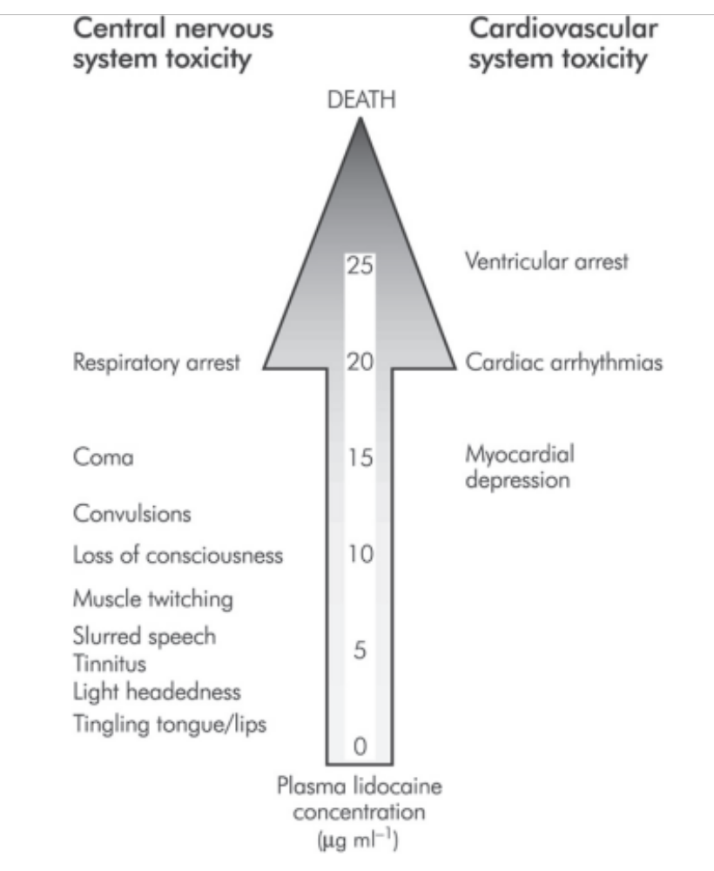
Toxicity
Notes:
All familiar with toxicity of LA
-May not follow classical progression of symptoms

Slide 30
Toxicity: Signs and symptoms
Neurological symptoms appear early:
  Tinnitus
  Metallic taste
  Perioral numbness
  Lightheadedness/dizziness
  Slurred speech
  Confusion
  Tonic-clonic seizures
Late neurological signs
  Coma, respiratory depression

Slide 31
Toxicity: signs and symptoms
Cardiovascular signs occur later:
  Bradycardia
  ECG abnormalities: prolonged PR interval, QRS widening
  Conduction abnormalities: heart block
  Myocardial depression – hypotension
  Cardiovascular collapse

Slide 32
Monitoring for Toxicity
Regular monitoring for symptoms of toxicity required
  Protocols vary regarding frequency etc.
Cerner PowerPlan monitoring requirements:
  Toxicity assessment, sedation score, pain score, vitals:
    q15 min for 1 hour
    q1hour for 4 hours
    q2 hours for duration of infusion
  ECG monitoring required for first few hours

Slide 33
Toxicity: Management
If signs or symptoms of toxicity, HR < 60, POSS>3:
  Stop lidocaine infusion
    short half-life, symptoms may resolve within 20 min
  Oxygen 10L/min
  Contact APS physician
  Obtain Intralipid 20% 100mL bags
    Should be available on unit

Slide 34
Toxicity: Management
If more critical condition (reduced LOC, severe hypotension etc.):
  Contact CCOT, call code etc.
  Intralipid, airway management, cardiovascular support may be required in severe cases
  Inform ICU/code team of lidocaine infusion

Slide 35
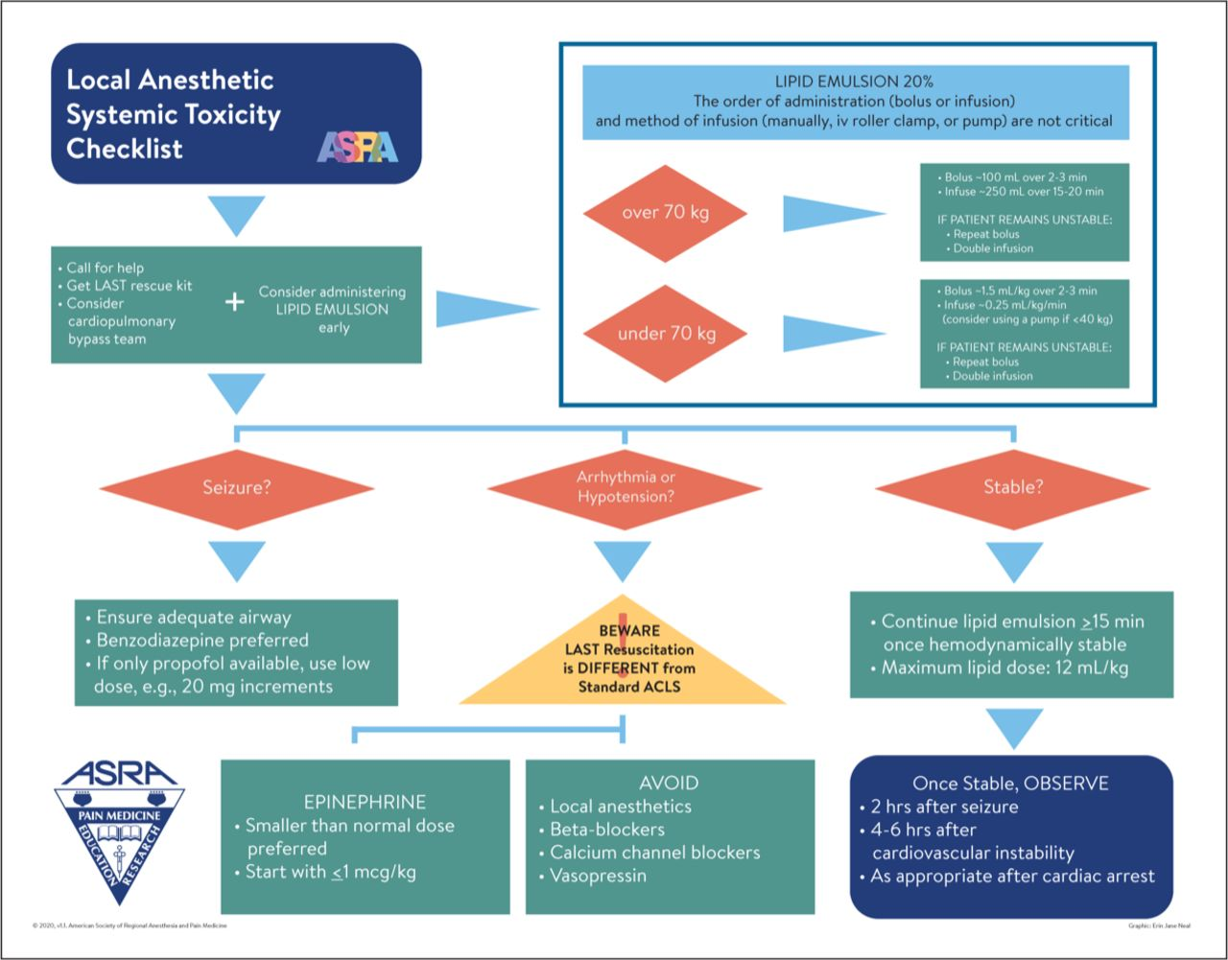
LAST Algorithm

Slide 36

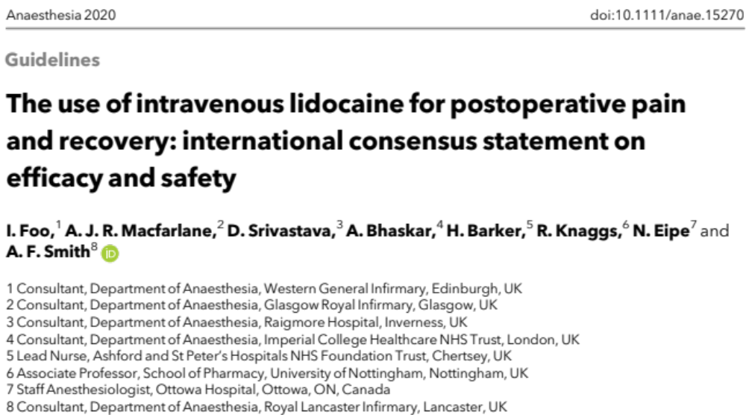

Slide 37
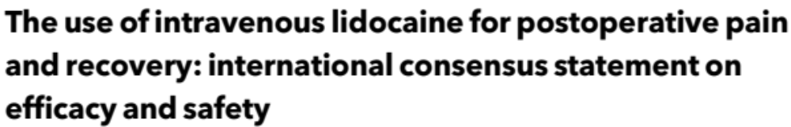
Ideal body weight should be used for dose calculation.
  ideal body weight = height in cm - 100
  ideal and actual body weight are similar if the BMI is < 30
IV lidocaine should not be used if pts weight <40kg.
For any patient, no more than 120mg/h should be infused.
Notes:
-Current powerplan uses actual weight.
SPH manually change to IBW
Reverts back to actual if PP placed in saved state.
Current max dose is 180mg/h

Slide 38
IV lidocaine should not be used within the period of action of other local anaesthetic interventions.
The following recommendations are based on a consensus among the working group:
  IV lidocaine should not be started within 4 h of any nerve or fascial plane block, or infiltration of laparoscopic port sites.
  No nerve or fascial plane blocks, or boluses of LA into wound or epidural catheters should be performed until 4 h after completion of an IV lidocaine infusion.

Slide 39
A loading dose of IV lidocaine of no more than 1.5 mg/kg, given as an infusion over 10 min is recommended
  Initial dose should be given with an anaesthetist present
  Continuous ECG and pulse oximetry and NIBP q5min during initial infusion and for the first 15 minutes thereafter
  Complete initial infusion before skin incision if possible.
After an initial loading dose, an infusion of IV lidocaine at 1.5 mg/kg/hr is recommended.
  No evidence supporting one dose over another for the initial dose or subsequent infusion

Slide 40
Duration of infusion should not generally exceed 24 h
  In practice, 24 h is often sufficient as postoperative pain will decrease with time and other analgesics can still be given.
  Most patients do not benefit from prolonged infusion, though some (for instance, those with chronic pain) might.
  If the infusion is to be extended after 24 h, the infusion rate should be reduced to 50%.

Slide 41
Outside the OR/PACU, patients receiving IV lidocaine infusions should ideally be managed in a monitored bedspace.
  Patients should be informed about what to expect and report
  Nurses should be trained in the signs of toxicity.
  Vigilance is needed in patients with existing comorbidity.
  Acute pain team should be involved in monitoring and follow up
.
Notes:
-No HDU
-Keep more pts in PACU?

Slide 42
Lipid emulsion 20% should be readily available wherever IV lidocaine is used, and staff should know where it is kept.
Clinicians should remember the possibility of toxicity even though there may be other explanations for a given clinical presentation.
Notes:
-Currently lipid emulsion available in OR and ICU.

Slide 43
Administration
Baseline 12 lead ECG to exclude cardiac conduction abnormality
Lidocaine infusion started in an area with cardiac monitoring
  Usually OR or PACU. Also HAU or ICU.
Initial loading dose 1.5mg/kg ideal body weight, given by physician
Infusion started, typically at 1 or 1.5mg/kg/hour
Must remain in cardiac monitored area for first hours of infusion
If stable can transfer to surgical floor
Discontinue at 24 hours in most cases
Reduce dose if continuing infusion to 48 hours

Slide 44
Questions?

