Slide 1

Pain & Perioperative Opioid Safety
PJ Matras, RN, MN
Clinical Nurse Specialist Pain Management
Providence Health Care

Slide 2
Outline
What is pain?
Pain Experience
Chronic Post Surgical Pain
Persistent post operative opioid use
Preoperative risks and optimization
Functional pain goals and assessment
Perioperative opioid safety

Slide 3
IASP Pain Definition (Revised 2020)
“An unpleasant sensory and emotional experience associated with, or resembling that associated with, actual or potential tissue damage.”¹
1.Raja, S., Can, D., Cohen, M. (et al).(2020) The revised International Association for the Study of Pain definition of pain: concepts, challenges and compromises. Pain, 161, 1976-1982

Slide 4
Context
Pain is always a personal experience that is influenced to varying degrees by biological, psychological, and social factors.
Pain and nociception are different phenomena.
Pain cannot be inferred solely from activity in sensory neurons.
Through their life experiences, individuals learn the concept of pain.
A person’s report of an experience as pain should be respected
Verbal description is only one of several behaviors to express pain; inability to communicate does not negate the possibility that a human or a nonhuman animal experiences pain.
Raja, S., Can, D., Cohen, M. (et al).(2020) The revised International Association for the Study of Pain definition of pain: concepts, challenges and compromises. Pain, 161, 1976-1982

Slide 5
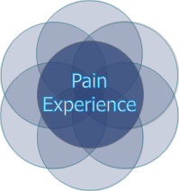
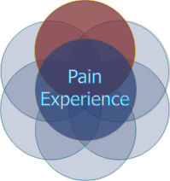
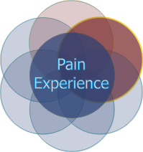
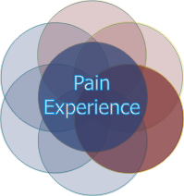
Pain Experience
Sensory
Emotional
Spiritual
Cognitive
Behavioral
Socio-Cultural
Notes:
Note to speaker: This slide has animation. Push the arrow down key (↓) to activate the circle for each topic.
Pain is more than a physical process. It is a multidimensional experience that can have an impact on all facets of quality of life. Key dimensions of pain are the sensory, emotional, spiritual, behavioral, cognitive, and socio-cultural aspects.
(↓) The sensory component encompasses the physiological mechanisms of nociception: genetic, anatomic, and physical determinants of pain. It influences how painful stimuli are recognized and described. Slides (9-13) described this component.
(↓) The emotional component of pain refers to the affective response to the pain experience: anger, fear, depression, and anxiety. Many studies have documented a link between depression and pain with a negative effect on function. Treating depression in patients with persistent pain may not only relieve depressive symptoms but also decrease pain.
(↓) The emotional and existential distress of pain can cause suffering, which is defined as the state of severe distress associated with threats to a person’s sense of wholeness. Those who suffer often experience spiritual distress. Achieving pain relief is an important step in relieving suffering. Assessing ways in which a person’s spirituality influences and is influenced by pain also is important.
(↓) Note to speaker: Go to next slide to continue with the behavioral component.

Slide 6
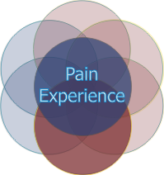
Pain Experience
Sensory
Spiritual
Emotional
Cognitive
Behavioral
Socio-Cultural
Notes:
The behavioral component consists of the observable actions used to express or control the pain such as facial grimacing, guarding, restlessness, or immobility. Nonverbal patients, such as those with advanced dementia, may demonstrate changes in behavior, and may become less physically active or more socially withdrawn or agitated or combative when they experience pain. Behavioral strategies such as distraction and imagery can be used to manage their pain.

Slide 7
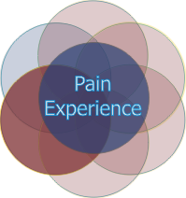
Pain Experience
Sensory
Spiritual
Emotional
Cognitive
Behavioral
Socio-Cultural
Notes:
The cognitive component of pain refers to beliefs, attitudes, memories, and meaning attributed to the pain. The meaning of the pain to the patient can be particularly important. The marathon winner with muscle cramping has a very different experience than the cancer patient with low back pain secondary to metastases. The patient who possesses a sense of control over his pain will likely have a much different response to post-operative pain than the person who doesn’t feel in control. Therefore, thoughts and attitudes influence the ways in which a person responds to pain and must be considered in development of a comprehensive treatment plan.
The cognitive dimension also includes pain-related beliefs and the cognitive coping strategies. Some people cope with pain by distracting themselves; others convince themselves that the pain is permanent, untreatable, and overwhelming. People who believe that their pain in uncontrollable and overwhelming (that is, people who catastrophize about their pain) are more likely to have poorer clinical outcomes. Attitudes and thoughts also determine a patient’s goals for and expectations about treatment. Finally, factors that affect cognition, such as sedation, dementia, delirium, and mental disability, alter the response to pain and make it more difficult to assess and treat.

Slide 8
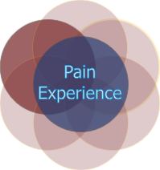
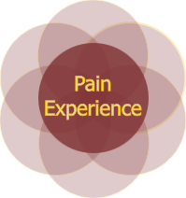
Pain Experience
Sensory
Emotional
Spiritual
Behavioral
Cognitive
Socio-Cultural
Notes:
The socio-cultural dimension of pain includes factors such as age, gender, education, socioeconomic status, support systems, social roles, and culture. Age, gender, and education can influence pain perception, as well as beliefs and coping strategies. Age and gender also influence nociceptive processes and responses to opioids. Families influence the patient’s response to pain through their beliefs and behaviors. For example, families may discourage the patient from taking opioids because they fear addiction. Culture also affects the experience of pain, specifically, pain expression, medication use, and pain-related beliefs and coping.
Thus all of these factors influence the pain experience.
Note to speaker: Please push the arrow down key (↓ ) to advance to the next slide.

Slide 9
Post Operative Pain
Over 80% of people report post operative pain²
  75% of those reported moderate-extreme during the immediate post op period²
Post operative pain is a significant concern for patients¹
Unmanaged post operative pain is associated with^{1,2,3}:
  Increased LOS
  morbidity and mortality
  Delayed recovery
Mazda, Y, Jadin, S., Khan, J. (2021). Postoperative Pain Management. Canadian Journal of General Internal Medicine, 16, (1)
Gan, T., (2017). Poorly controlled postoperative pain: prevalence, consequences and prevention. Journal of Pain Research, 10, 2287-2298.
Fetcher, D., Stamer, U, et al, (2015). Chronic postsurgical pain in Europe. European Journal of Anesthesiology, 32,725-734.
Notes:
2. Observational study – 11 countries 889 patients

Slide 10
Post Operative Pain
Con’t:
  Poor physical function and quality of life
  Prolonged opioid use during and after hospitalization
  Repeat hospital admissions
  Increased risk of persistent (chronic) post surgical pain
    The percentage of time in severe pain during the first 24 h after surgery identified as a new risk factor ²
      Each 10% increase in percentage of time in severe pain after surgery was associated with a 30% increase in incidence of chronic post surgical pain³
Mazda, Y, Jadin, S., Khan, J. (2021). Postoperative Pain Management. Canadian Journal of General Internal Medicine, 16, (1)
Gan, T., (2017). Poorly controlled postoperative pain: prevalence, consequences and prevention. Journal of Pain Research, 10, 2287-2298.
Fetcher, D., Stamer, U, et al, (2015). Chronic postsurgical pain in Europe. European Journal of Anesthesiology, 32,725-734.

Slide 11
Chronic Post Surgical Pain (CPSP) – updated 2019
“Chronic postsurgical or posttraumatic pain is pain that develops or increases in intensity after a surgical procedure or a tissue injury and persists beyond the healing process, ie, at least 3 months after the initiating event.”¹
1. Schug, S., et. al.(2019). The IASP classification of chronic pain for ICD-11: Chronic postsurgical or posttraumatic pain. Pain, 160, 1

Slide 12
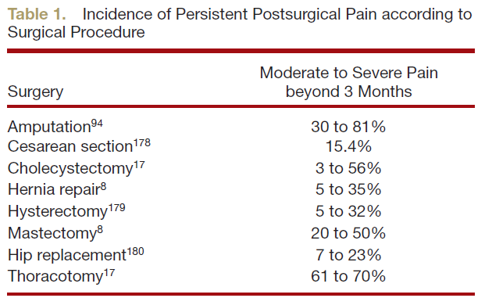
Incidence of CPSP
2-10% have severe pain 6 months post surgery²
The rate of neuropathic pain is variable but can be high depending on the surgery²
Richebe, P, Capdevila, X., & Rivat, C. (2018). Persistent postsurgical pain: Pathophysiology and preventative pharmacologic considerations. Anesthesiology, V 129 (3)
Schug, S., et al. (2019). The IASP classification of hronic pain for ICD-11: chronic postsurgical or posttraumatic pain. PAIN, 160, (1)
Notes:
Complex heritable trait with heritability in the range of 30-17%

Slide 13
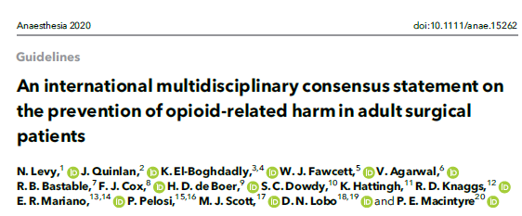
Persistent post operative opioid use
“patients taking any opioids prescribed for postoperative pain for longer than 90 days after surgery.”¹
Levy, N., (et. Al. (2020). An international multidisciplinary consensus statement on the prevention of opioid-related harm in adult surgical patients. Anaesthesia 2020.
Notes:
For the purposes of our talk – we will use the concensus statements definition

Slide 14
Persistent post operative opioid use
CPSP is associated with persistent post operative opioid use^{1,2,3}
Persistent opioid use post surgery is associated with a decrease in quality of life, injury and cardiac events^{1,2}
From April 2020-2021 in the USA there were 75,673 people who died of opioid overdose²
  Nearly ¼ of these directly involved prescription opioids²
Clarke, H, et. al. (2014). Rates and risk factors for prolonged opioid use after major surgery: population based cohort study. British Medical Journal, 348;
Larach, D, Hah, J. (2022). Perioperative opioids, the opioid crisis, and the anesthesiologist. Anesthesiology, V, 136.
Levy, N., (et. Al. (2020). An international multidisciplinary consensus statement on the prevention of opioid-related harm in adult surgical patients. Anaesthesia 2020.

Slide 15
Persistent post operative opioid use
~4-8% of opioid naïve patients continue to take opioids more than 3 months after surgery³
  1.35 million patients undergoing any type of in hospital surgery and found 2.2% still using opioids at 6 months² (~29,000 people)
  4.3-8.3% continued opioids at 6 months for TKA, and hip arthoroplasty
    4.8% continued to fill opioid RX for common pediatric surgeries²
35-77% of people on opioids pre-op continue to take opioids for more than 3 months³
Clarke, H, et. al. (2014). Rates and risk factors for prolonged opioid use after major surgery: population based cohort study. British Medical Journal, 348;
Larach, D, Hah, J. (2022). Perioperative opioids, the opioid crisis, and the anesthesiologist. Anesthesiology, V, 136.
Levy, N., (et. Al. (2020). An international multidisciplinary consensus statement on the prevention of opioid-related harm in adult surgical patients. Anaesthesia 2020.

Slide 16
Pre-operative risk factors^{1,2}
Pre-operative opioid use
  Can be up to 10 times more likely to continue opioids long term than those opioid naïve
  Pre-op opioids assoc with perioperative mortality & morbidity, ? r/t opioid induced immunosuppression³
Chronic pain
Younger age
Pre-operative fear, anxiety, depression
Catastrophic thinking (negative affectivity)
Substance use disorders
  Tobacco, alcohol, cocaine
Patient expectations
Levy, N., (et. Al. (2020). An international multidisciplinary consensus statement on the prevention of opioid-related harm in adult surgical patients. Anaesthesia 2020.
Clarke, H, et. al. (2014). Rates and risk factors for prolonged opioid use after major surgery: population based cohort study. British Medical Journal, 348;
Larach, D, Hah, J. (2022). Perioperative opioids, the opioid crisis, and the anesthesiologist. Anesthesiology, V, 136.
Notes:
Genetics
Age
Surgery

Slide 17
Pre-op planning
Pain Education^{1,2}
  Multimodal analgesia
  Realistic goals and expectations
  Reassurance that pain after surgery is common
  Education about opioids – risks and side effects
Management of anxiety and depression pre-op^{1,2}
  Referral may be necessary
  Mindfulness based techniques can help
Try to wean opioids pre-operatively¹
Levy, N., (et. Al. (2020). An international multidisciplinary consensus statement on the prevention of opioid-related harm in adult surgical patients. Anaesthesia 2020.
Larach, d., Ha, J., Brummett, C (2022). Perioperative opioids, the opioid crisis, and the anesthesiologist. Anesthesiology, V, 136, 594-608.
Larach, D, Hah, J. (2022). Perioperative opioids, the opioid crisis, and the anesthesiologist. Anesthesiology, V, 136.
Notes:
Tapers improve post operative pain, improves function and improvement in depression and anxiety
Insight timer, headspace, music distraction, positive expectations

Slide 18
Post operative
Pain Assessment

Slide 19
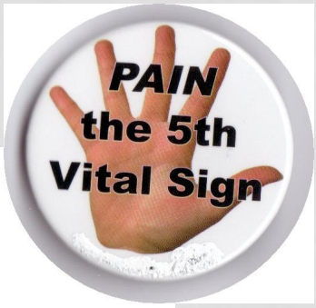

Pain is the 5th Vital Sign
What went wrong?
Notes:
Highlighted need to treat pain and improve pain care
Mandatory pain screening without context
Titration of opioids to a one-dimensional pain scale doubled risk of opioid-induced ventilatory impairment
Pain satisfaction not necessarily associated with safe pain care -

Slide 20
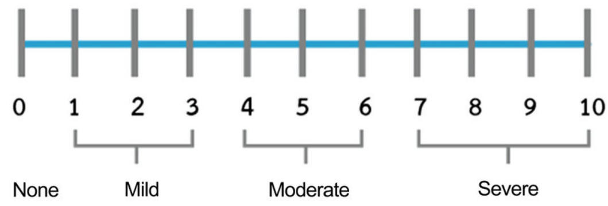
Assessment
Pain Severity Scales
Easy to use
One dimension of pain only
They are well validated (NRS, VAS, VDS and faces, BPS) ¹
Pain severity scales use is limited when used as the sole pain assessment¹
Over reliance on one dimensional scales may provide unrealistic expectations²
Mariano, E. (et al.) (2021). A multisociety organizational consensus process to define guiding principle for acute perioperative pain management. American Society of Regional Anesthesia and Pain Medicine, 0 (1)
Levy, N., (et. Al. (2020). An international multidisciplinary consensus statement on the prevention of opioid-related harm in adult surgical patients. Anaesthesia 2020.

Slide 21

Context matters
https://www.buzzfeed.com/daves4/best-wrong-number-text-responses

Slide 22


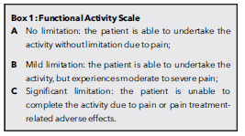
Function
Add functional outcome to complement pain intensity scales^{1,2}
Not all post operative pain is opioid responsive^{1,2}
Mariano, E. (et al.) (2021). A multisociety organizational consensus process to define guiding principle for acute perioperative pain management. American Society of Regional Anesthesia and Pain Medicine,
Levy, N., (et. Al. (2020). An international multidisciplinary consensus statement on the prevention of opioid-related harm in adult surgical patients. Anaesthesia 2020.
Notes:
Conjuction junction what’s your function

Slide 23
Nociceptive (Acute) Pain Management
PHARMACOLOGIC
Nonopioids
Acetaminophen
NSAIDS/Cox2
Opioids**
Adjuvants
Muscle relaxants
Lidocaine
Ketamine
Gabapentinoids*
Regional techniques
  Epidural
  Perineural
  Single shot blocks
PSYCHOLOGIC
Distraction
Relaxation
Education – pain related surgical or procedural
Pain assessment*
Mindfulness techniques
  Insight timer, headspace ($), resources
Management of anxiety & depression
Communication
  Trust
Movement
PHYSICAL
Cold/warm
Splitting/casting
Sling
Elevation
Rest – short term
Time
Mariano, E (et al.). (2021). A multisociety organizational consensus process to define guiding principles of acute perioperative pain management. Regional Anesthesia and Pain Medicine
Small, C., 7 Laycock, H. (2020). Acute postoperative pain management. British Journal of Medicine, 107, e70-80
Mazda, Y, Jadin, S, Khan, J. (2021). Postoperative pain management. Canadian Journal of General Internal Medicine, 16, (1)
Notes:
Current evidence does not support the routine use of perioperative gabapentinoids in patients who are not already taking them at baaseline

Slide 24
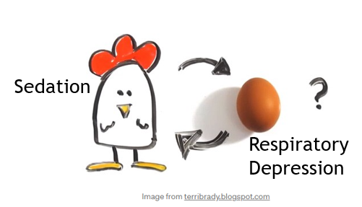
What comes first in relation to opioids?

Slide 25

Sedation
Notes:
RR

Slide 26
Reducing risk¹
Sedation is the most reliable clinical marker of opioid-induced ventilatory impairment
  RR or SPO₂ does not correlate well to arterial partial pressures of carbon dioxide
Patient receiving opioids should have their level of sedation assessed at appropriate time intervals
Patient needs to be woken to assess for sedation
Recommended to use a sedation scale that does not use ‘S’ for sleep
Levy, N., (et. Al. (2020). An international multidisciplinary consensus statement on the prevention of opioid-related harm in adult surgical patients. Anaesthesia 2020.

Slide 27
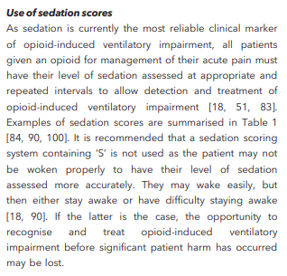
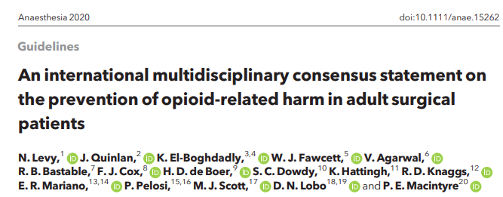
Something to think about?

Slide 28
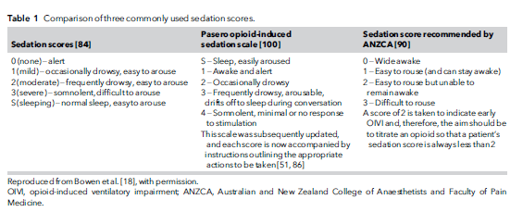
Sedation Scales
Levy, N., (et. Al. (2020). An international multidisciplinary consensus statement on the prevention of opioid-related harm in adult surgical patients. Anaesthesia 2020.
Notes:
RASS for intubated

Slide 29
PHC
Pasero Opioid-Induced Sedation Scale (POSS)^{[i]}
Score | Meaning of Score
1 | Awake and alert | Acceptable
2 | Slightly drowsy, easily roused | Acceptable
3 | Frequently drowsy, rousable, drifts off to sleep during conversation | Unacceptable
4 | Somnolent, minimal or no response to verbal and physical stimulation | Unacceptable
S ** | Sleep, easy to rouse | Acceptable
**NOTE: During the first 24hours after surgery and/or 24 hours after initiation of an opioid or 24 hours after an opioid increase, patient must be woken.
S score is not acceptable during this time period
Notes:
This scale is not used when sedating a patient for a procedure. Endoscopy and OR procedures do not use this for assessment for procedural sedation.
Critical care uses a different sedation scale in order to ventilate patients (ie purpose is different)
Point out that this scale is on the Pocket guide.

Slide 30

POSS 3
Drifts off to sleep during conversation
Notes:
Pt wakes easily but does NOT stay awake without repeated stimulation
Even if pt rates pain high, it is unsafe to give opioid or sedating medication at this time.
If asking for pain medication, what can you offer?
-a non-sedating, non-opioid analgesic for pain, e.g. acetaminophen or NSAID

Slide 31

Who is at risk of opioid induced ventilatory impairment?

Slide 32
Risk factors for opioid related ventilatory impairment ^{1,2}
Age > 55
Obesity
Sleep disordered breathing
Untreated OSA
Renal impairment
Respiratory, cardiac and neurological diseases
Diabetes mellitus
Co administration of sedating meds
Dependent functional status
Smoker
Opioid naïve
Opioid tolerant
Prolonged surgery
Thoracic/lg incision
Continuous infusions
Note:
Many who develop opioid-induced ventilatory impairment have NO IDENTIFIABLE risk factors
Levy, N., (et. Al.) (2020). An international multidisciplinary consensus statement on the prevention of opioid-related harm in adult surgical patients. Association of Anaesthetists.
Lynn, L, curry, P. (2011). Patterns of unexpected in-hospital deaths: a root cause analysis. Patient Safety in surgery, 5 (3)

Slide 33
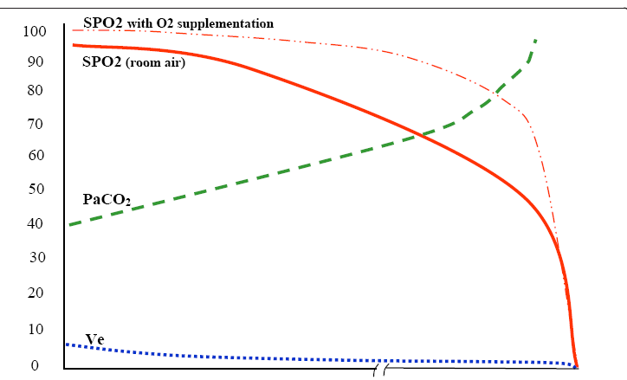
Type II pattern of unexpected death (CO2 narcosis)
Progressive rise in PaCO2 (and etCO2) and fall in SPO2 over 15 minutes to many hours. (Often due to too much opioid or sedatives)
Pa CO2: 35 – 45 mmhg = normal
What is the patient’s sedation level?
Levy, N., (et. Al.) (2020). An international multidisciplinary consensus statement on the prevention of opioid-related harm in adult surgical patients. Association of Anaesthetists.
Lynn, L, curry, P. (2011). Patterns of unexpected in-hospital deaths: a root cause analysis. Patient Safety in surgery, 5 (3)
Notes:
33
The bottom blue line represents how well a patient is moving air in and out of the lungs per minute or ventilating. Tidal volume and the Respiratory rate.
Note the shallow breathing and decreasing rate are shown by the decreasing blue line.
3. The PaCO2 is rising (green line – not getting rid of a rising C02). The effective ventilation is becoming ineffective – shallow breathing, ineffective and decreasing resp. rate.
The rising carbon dioxide competes with the oxygen for space at the alveolar interface. You will see the falling SpO2 reasonably soon in patients breathing room air. SpO2 is moderately sensitive when breathing room air.
Note the SpO2 value dotted line continues further along before dropping. This shows how extremely insensitive SpO2 monitoring is when supplemental oxygen is used.
What is the workhorse muscle for effective breathing? Diaphragm.
What can you do with your patient for more effective breathing? Sit up – most effective position for diaphragm, deep breathe and cough
KEY Points:
1. What is the most sensitive indicator for impending resp. depression? change in sedation level – Early Warning System (sedation score - canary in the coal mine)– impending respiratory depression (long before Sp02 )
2. Assess the patient directly: visual and respiratory assessment – effective vs. ineffective breathing, etc.
3. Oxygen use may provide a false sense of security and may delay critical responses to a deteriorating clinical condition.

Slide 34

Post operative management^{1,2,3}
Use a functional pain goals
  Realistic goals
Communication
  Not as easy as it looks
Multimodal analgesia
  Acetaminophen
  +/-NSAID’s
  Ketamine/lidocaine
  Opioids
  Regional techniques
Levy, N., (et. Al.) (2020). An international multidisciplinary consensus statement on the prevention of opioid-related harm in adult surgical patients. Association of Anaesthetists.
Mariano, E (et al.). (2021). A multisociety organizational consensus process to define guiding principles of acute perioperative pain management. Regional Anesthesia and Pain Medicine
Mazda, Jadin, Khan, (2022) Post operative pain management. Canadian Journal of General Internal Medicine, 16,1
Notes:
Research suggests no significant effect with cannibinoids and gabapentin on perioperative management

Slide 35
Post op Management^{1,2,3}
Opioids
  Assess if opioid responsive – escalating doses without intended pain reliefrisk
  Age adjust opioid dosing
  Titrate opioids to function
  Regular ± prn
Use immediate release opioids only (Avoid long-acting formulations)
Concurrent use of opioids and other sedating meds (including benzo’s and gabapentinoids) risk
Levy, N., (et. Al.) (2020). An international multidisciplinary consensus statement on the prevention of opioid-related harm in adult surgical patients. Anaesthesia 2020.
Mariano, E (et al.). (2021). A multisociety organizational consensus process to define guiding principles of acute perioperative pain management. Regional Anesthesia and Pain Medicine
Mazda, Jadin, Khan, (2022) Post operative pain management. Canadian Journal of General Internal Medicine, 16,1

Slide 36
Post operative Pain-Challenges
Appreciation that severe acute pain can lead to changes in the nervous system that result in chronic pain (neuroplasticity)^{1,2,3}
Higher doses of opioids can sometimes result in worsening pain and acute tolerance (hyperalgesia)^{1,2,3}
Not all pain responsive to opioids – How do you know?
  increased pain may lead to increasing ineffective opioid doses^{1,2,3}
Application of multimodal balanced analgesia
Assessment²
Timely responses²
Safety Issues^{1,2,3}
Levy, N., (et. Al. (2020). An international multidisciplinary consensus statement on the prevention of opioid-related harm in adult surgical patients. Anaesthesia 2020.
Larach, d., Ha, J., Brummett, C (2022). Perioperative opioids, the opioid crisis, and the anesthesiologist. Anesthesiology, V, 136, 594-608.
Small, C., 7 Laycock, H. (2020). Acute postoperative pain management. British Journal of Medicine, 107, e70-80
Notes:
12

Slide 37
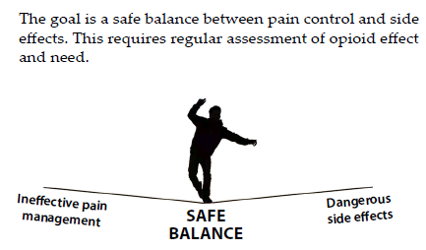
Preparing for discharge
Education^{1,2}
  Recommend trialing nonopioid analgesia
  Provide information of the anticipated duration of opioid consumption after surgery
  Set expectation for the lowest opioid dose for the shortest amount of time
Levy, N., (et. Al. (2020). An international multidisciplinary consensus statement on the prevention of opioid-related harm in adult surgical patients. Anaesthesia 2020.
Larach, d., Ha, J., Brummett, C (2022). Perioperative opioids, the opioid crisis, and the anesthesiologist. Anesthesiology, V, 136, 594-608.
Small, C., 7 Laycock, H. (2020). Acute postoperative pain management. British Journal of Medicine, 107, e70-80

Slide 38
Preparing for discharge
Education^{1,2}
  Proper storage and disposal
    Patients typically stop taking opioids for post op pain before pain cessation occurs²
  Signs of too much opioid
  Signs of withdrawal
Levy, N., (et. Al. (2020). An international multidisciplinary consensus statement on the prevention of opioid-related harm in adult surgical patients. Anaesthesia 2020.
Larach, d., Ha, J., Brummett, C (2022). Perioperative opioids, the opioid crisis, and the anesthesiologist. Anesthesiology, V, 136, 594-608.
Small, C., 7 Laycock, H. (2020). Acute postoperative pain management. British Journal of Medicine, 107, e70-80

Slide 39

Conclusion
Pain is a multifaceted personal experience
Optimum pain management starts before surgery
Pain assessment is more than a one dimensional pain scale
  Context matters ☺
Goal of post operative pain management is to restore function rather than eliminate pain
Opioids require a safe balance
  Sedation assessment is imperative to safety

Slide 40
References
Clarke, H., Soneji, N., Ko, D., Longson, Yun, Wijeysundera, D. (2014). Rates and risk factors for prolonged opioid use after major surgery: population based cohort study. British Medical Journal, 348, doi: 10.1136/bmj.g1251
Fletcher, D., Stamer, U, Pogatski-Zahn, E. (et. al). (2015). Chronic postsurgical pain in Europe: An observational study. European Journal of Anesthesiology, 32, 725-734. DOI:10.1097/EJA.0000000000000319
Gan, T. (2017). Poorly controlled postoperative pain: prevalence, consequences, and prevention. Journal of Pain Research, 10, 2287-2298.
Larach, D., Hah, J., & Brummett, C.(2022). Perioperative opioids, the opioid crisis and the anesthesiologist. Anesthesiology, V 136, (4), 594-608. doi:10.1097/ALN.00000000004109
Levy, N., Quinlan, J., El-Boghdadly, K., et. al. (2020). An international multidisciplinary consensus statement on the prevention of opioid-related harm in adult surgical patients. Anaesthesia 2020. Doi: 10.1111/anae.1562
Mazda, Y., Jadin, S., & Khan, J. (2021). Postoperative pain management. Canadian Journal of General Internal Medicine, 16,(1). Doi: 1022374/cjgim.v16isp1.529
Mariano, E, Dickerson, D., Szokol, J. et. Al. (2021). A multisociety organizational consensus process to define guiding principles for acute perioperative pain management. Regional Anesthesia and Pain Medicine., 0,(1). 1-10. doi: 10.1136/rapm-2021-103083
Raja, S., Can, D., Cohen, M. (et al).(2020) The revised International Association for the Study of Pain definition of pain: concepts, challenges and compromises. Pain, 161, 1976-1982 doi.org/10.1097/j.pain.0000000000001939
Richebe, P, Capdevila, X. & Rivat, C. (2018). Persistent postsurgical pain: Pathophysiology and preventative pharmacologic considerations. Anesthesiology, V129, (3), 590-607.
Schug, S., Lavand’homme, P, Barke, A., Korwisi, B., Rief, W., Treede, RD. (2019). PAIN, 160,(1). Doi:.org/10.1097/j.pain.00000000001413
Small, C. & Laycock, H. (2020). Acute postoperative pain management. British Journal of Surgery, 107, 70-80.
VA PRN Program Curriculum and Planning Guide Copyright 2012 • University of Wisconsin Board of Regents

