Slide 1
Perioperative Brain Health in the Older Patient
Alana Flexman MD FRCPC
Department of Anesthesia | St. Paul’s Hospital | Providence Health Care
Centre for Health Evaluation and Outcome Sciences
UBC Clinical Associate Professor
Department of Anesthesiology, Pharmacology and Therapeutics

Slide 2




Disclosures/Acknowledgements
Research Support
Dept of Anesthesia
Providence Health Care
Financial Compensation

Slide 3
Objectives
Participants will be able to:
Identify risk factors for postoperative delirium
Implement delirium screening & assessment
Understand best practices to prevent and manage postoperative delirium
Identify areas that require further research

Slide 4
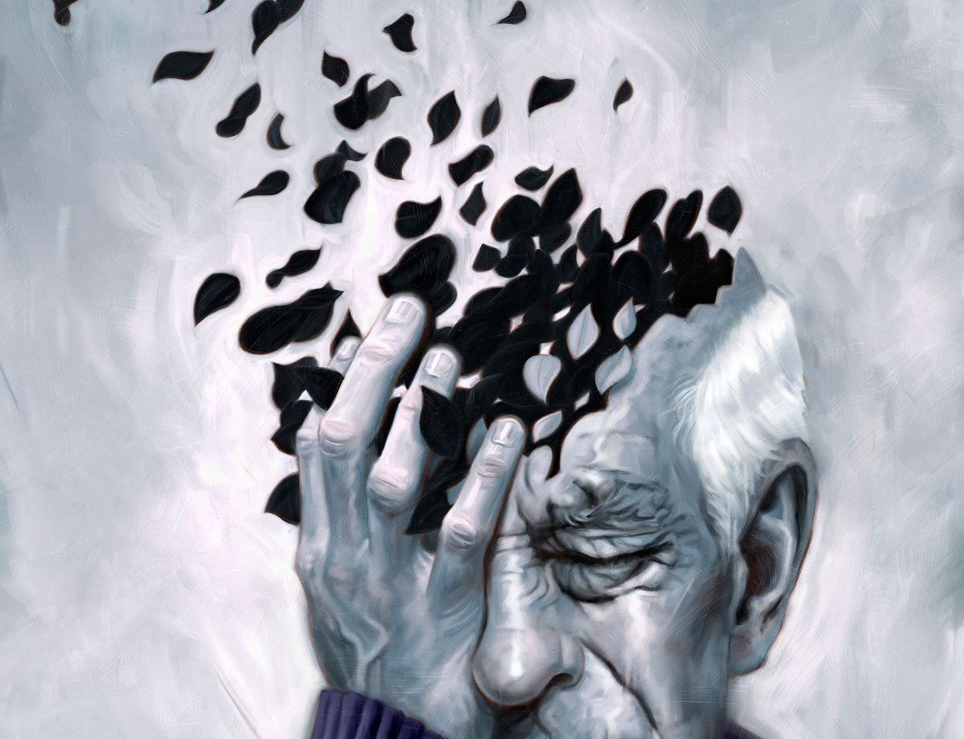
Notes:
Our surgical population is getting progressively, and with advances in surgical and anesthetic management we are able to safely take sicker patients through surgery
However, as surgical population becomes older and more complex, the risks increase, including neurologic complications
Preserving brain health is a significant concern for patients, with delirium being the most common neurologic complication

Slide 5
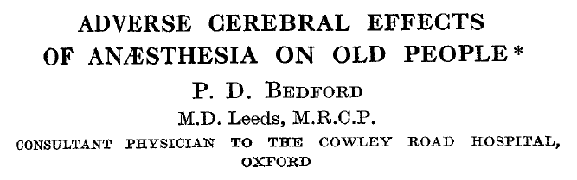
Bedford. Lancet 1955; 266: 259-264

Slide 6
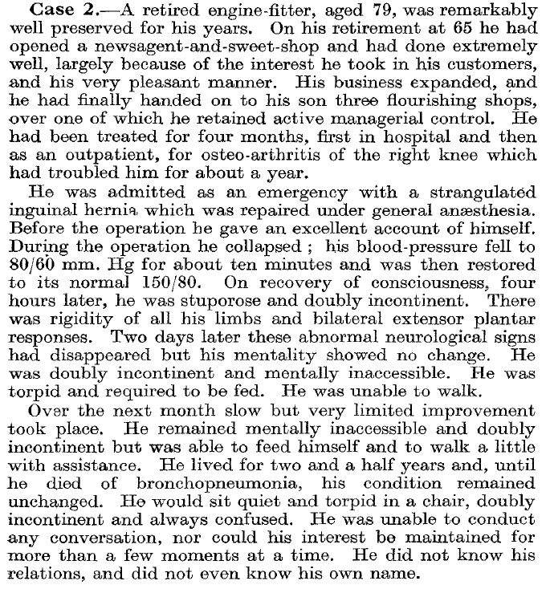

Slide 7
“It is well known, too, that in elderly people transitory confused states often follow operations under general anesthesia; but it is not so widely appreciated that minor dementias and even permanent catastrophic mental impairment may occasionally be the aftermath.”
Bedford. Lancet 1955; 266: 259-264

Slide 8

Back to 2022
Patients are worried about it
Surgical population is aging
Associated with long term cognitive dysfunction, functional impairment and mortality after surgery
Peden et al. BJA 2019;123(4):464-78
Notes:
30% have POCD at 1 month, and 10% at one year
Relationship of surgery & anesthesia with long term dementia unclear
We are going to focus on postoperative delirium

Slide 9
Definitions

Slide 10
Brain Health: Definitions
Surgery & Anesthesia
Immediate (PACU)
Emergence delirium
Up to 30 days
Postoperative delirium
Delayed neurocognitive recovery
Perioperative Stroke
30 days to 1 year
Postoperative cognitive dysfunction
Major/minor neurocognitive disorder (postoperative)
After one year
Neurocognitive disorders (dementia)
Evered et al. BJA 2018;121:1005-21
Notes:
Delirium exists along a continuum of postoperative brain dysfunction

Slide 11
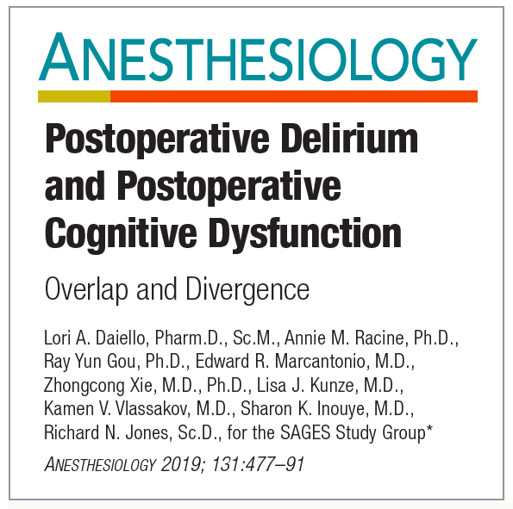
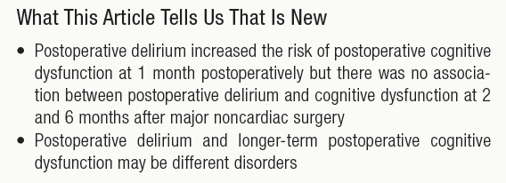
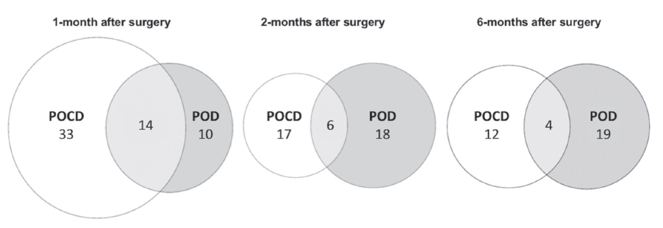
Daiello et al. Anesthesiology 2019;131:477-91

Slide 12
Perioperative Brain Health
Neuroinflammation
Accelerated neurodegeneration
Neurotoxicity
Post-Operative Cognitive Dysfunction
30-50%
Delirium
24%
Stroke
0.1-2%
Covert Stroke
Recurrent stroke/ischemia
Covert Stroke
Notes:
POCD 1 month
Important to remember that these complications occur after SURGERY AND ANESTHESIA

Slide 13

Postoperative Delirium
Acute confusional state
Clinical syndrome
Multiple mechanisms
Differential diagnosis:
  Dementia (baseline)
  Stroke
  Psychosis
  Alcohol withdrawl
Marcantonio NEJM 2017;277:I456-66

Slide 14
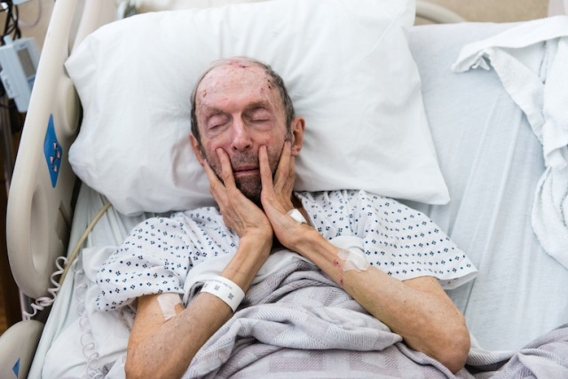

Delirium Subtypes
Hypoactive Delirium
Hyperactive Delirium
56-68%
1-10%
Mixed
21-31%
Robinson et al. Arch Srug 2011;146:295-300;
Albrecht et al. J Am Geriatr Soc 2015;63:970-6
Notes:
Worse outcomes with hypoactive - any subtype is important

Slide 15
Emergence Delirium
Acute confusional state during recovery from anesthesia
Predictor of subsequent postoperative delirium
Risk Factors: male, smoking, urinary catheter, postoperative pain (possibly age, inhalational anesthesia, benzo use)
Wei et al. Acta Anaesthes Scand 2021;65(6):719-729

Slide 16
Delirium Incidence & Screening

Slide 17
Incidence After Surgery
Major Surgery 15 to 25%
Hip Fracture ~50%
Cardiac Surgery ~50%
Ventilated ICU Patients ~70-80%
Marcantonio NEJM 2017;277:I456-66

Slide 18
Risk Factors: Baseline
Age >65 years
Chronic cognitive decline, stroke or dementia
History of delirium
Poor vision or hearing
Severe illness
Presence of infection
Frailty/functional decline
Lack of caregiver support
Mahanna-Gabrielle et al. BJA 2019; 123(4): 464-78
Watt et al. J Gen Int Med 2017;33:500-9
Notes:
Cognitive impairment is often missed if not formally assessed
Caregiver suppo

Slide 19
Risk Factors: Precipitating
DRUGS: New or with drawl
INFECTION: UTI, SSI, pneumonia Sepsis
METABOLIC: Hypoxia, hypercarbia, acidosis, electrolyte disturbance
STRUCTURAL: Intracranial process

Slide 20
Risk Factors: Precipitating
Benzodiazepines
Opioids (especially meperidine)
Non-benzo sleep aids (e.g. zopiclone)
Antihistamines
Alcohol
Anticholinergics (e.g. glycopyrrolate)
Mahanna-Gabrielle et al. BJA 2019;123:464-78

Slide 21
Should we screen for delirium?
53%
8-9%
3%
Chart Audit
Routine clinical care
Interview with nurse
Daily mental status test
Validated diagnostic algorithm
Notes:
Effect of screening for delirium – post cardiac surgery
Reference: Rudolph JL, Marcantonio ER. Review articles: postoperative
delirium: acute change with long-term implications. Anesth
Analg 2011; 112: 1202-11. (need to get original study reference)

Slide 22

Confusion Assessment Method (CAM)
Acute onset and fluctuating course
Inattention
Disorganized thinking
Altered level of consciousness
The diagnosis of delirium by CAM requires the presence of features 1 and 2 and either 3 or 4
Adopted from: Inouye et al. Ann Int Med 1990;113(12):941-48
Notes:
Acute onset
Inattention – can’t follow easily distracted
Disorganized – rambling or incoherent, unclear
LOC: altert (Normal) vs hypervigilant, lethargic, stupor or coma

Slide 23
3D-CAM
Feature 1: Change in Mental Status w/Fluctuating Course | Feature 2: Inattention | Feature 3: Disorganized Thinking | Feature 4: Altered level of consciousness
Patient interview for confusion, disorientation, hallucinations Observation of fluctuations in consciousness, attention or speech | Digit span tests Days of week backward Months backward Distractable? Unable to keep track of interview? | Patient states year, day of week, type of place (hospital) Assess flow of ideas, rambling, tangential, limited/sparse speech | Was patient sleepy? Stuporous or comatose? Hypervigilant?
The diagnosis of delirium by CAM requires the presence of features 1 and 2 and either 3 or 4
Marcantonio et al. Ann Intern Med. 2014;161(8):554-561
Notes:
3- minute diagnostic interview for delirium
Abbreviated form of CAM, practical
Digit span – count backwards in 3s or 4s

Slide 24
Other CAM Versions
CAM-ICU: Patient who are unable to speak, i.e. intubated or tracheostomy
  ICU setting: Sensitivity 53% Specificity 100%
  PACU setting: Sensitivity 32% Specificity 93%
FAM-CAM: Family assessment of delirium
  Family training: Sensitivity 88% Specificity 98%
  No training (ER): Sensitivity 57% Specificity 83%
Ely et al. JAMA 2001;286:2703-10; Neufeld et al. BJA 2013;111:612-18;
Steis et al. J Am Ger Soc 2012;60:2121-6; Mailhot et al. J Am Ger Soc 2020;00:983-90
Notes:
Compared to reference standards – either full CAM (in patients who could speak) or detailed interview

Slide 25
4AT
4+ Possible delirium/cognitive impairment
1-3: possible cognitive impairment
0: Delirium of cognitive impairment unlikely
ALERTNESS
AMT4: AGE, DOB, PLACE, YEAR
ATTENTION: MOS OF YEAR BACKWARDS
ACUTE CHANGE/FLUCTUATING
www.the4at.com
Notes:
Acute change in mental status
Quick, does not require training

Slide 26
Delirium Prevention & Management

Slide 27

Typical Recovery Room

Slide 28
Hospital Elder Life Program
Core Intervention | Examples
Daily visitor/orientation | Orientation board Orientating communication
Therapeutic activities | Cognitive stimulation activities TID e.g. discuss current events, structured reminiscence, word games
Early mobilization | Ambulation or active ROM activities TID Minimize immobilizing equipment
Vision & hearing protocols | Visual and hearing aids, adapted equipment (e.g. amplifiers)
Oral volume repletion, feeding assistance | Feeding & fluid assistance, encouragement during meals
Sleep enhancement | Nonpharmacologic protocol (milk, tea, music, noise reduction strategies)
Hospital Elder Life Program (HELP)
Inouye et al. JAGS 2000;48:1697-1706
Notes:
Elder life staff & volunteers implemented

Slide 29
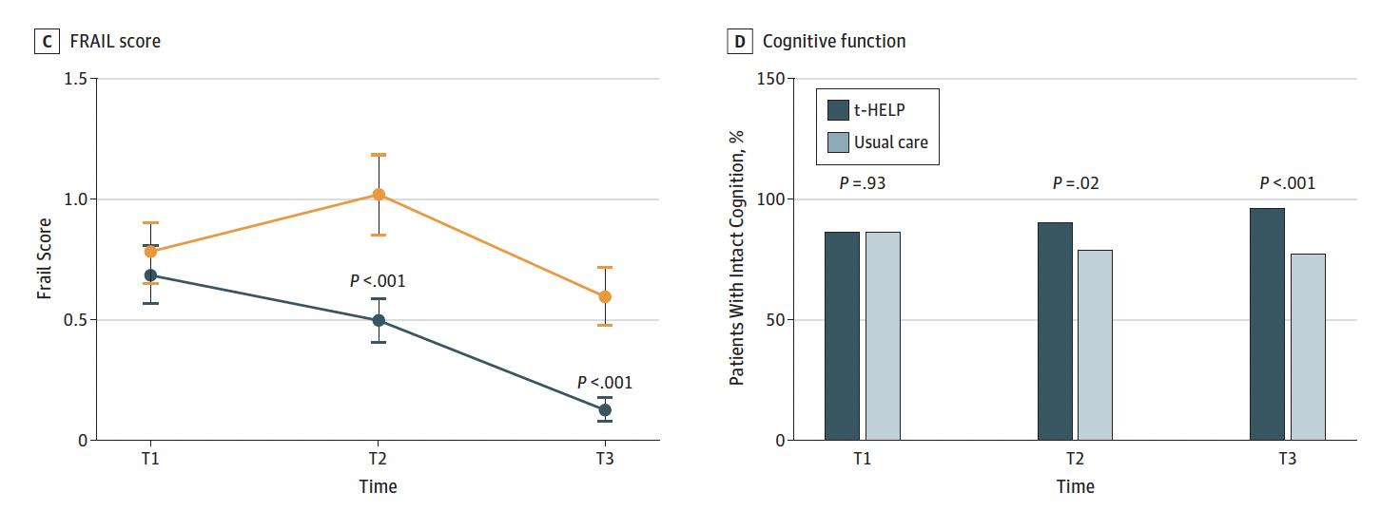
Tailored, Family-Involved HELP
Universal Protocols:
Orientation
Therapeutic activities
Early mobilization
Individual delirium risk assessment
8 targeted protocols (menu)
Family education & supervision
Reduced delirium from 19% to 3% and LOS by 4 days
Wang et al. JAMA Intern Med 2020;180(1):17-25
Notes:
6 surgical floors in hospital in China (cluster randomized by floor
Adapted to each patient – select from a menu. In addition, the authors note that family members are very involved in their family member’s care in hospitals in hospitals, therefore they used family members instead of volunteers

Slide 30
Tailored, Family-Involved HELP
Protocol | Use of Protocol | Adherence (>80%)
Early mobilization | 100% | 74%
Therapeutic activities | 100% | 51%
Orientation | 100% | 46%
Pain management | 76% | 53%
Sleep enhancement | 70% | 46%
Hearing enhancement | 52% | 52%
Nutrition assistance | 41% | 63%
Vision enhancement | 31% | 77%
Constipation management | 16% | 45%
Multiple medications management | 12% | 53%
Hypoxia management | 3% | 75%
Catheter-assoc UTI prevention | 3% | 50%
Wang et al. JAMA Intern Med 2020;180(1):17-25
Notes:
6 surgical floors in hospital in China (cluster randomized by floor
Adapted to each patient – select from a menu. In addition, the authors note that family members are very involved in their family member’s care in hospitals in hospitals, therefore they used family members instead of volunteers

Slide 31
Multifaceted Delirium Prevention Program for Surgery
Staff Education (41.5h)
Delirium expert nurse: risk assessment, rounds, patient visits, team handover
Intervention modules:
  Orientation visit (including aids)
  Mobilization
  Activation visit
  Meal accompaniment
  Relaxation/sleep promotion
  Diagnostic chaperonage
  Attendance to the OR
Reduced delirium by 14%;
Sensitivity analysis: Effective for non-cardiac surgery
(not cardiac)
Deeken et al. JAMA Surg 2021
Notes:
70 yrs and older
RCT

Slide 32
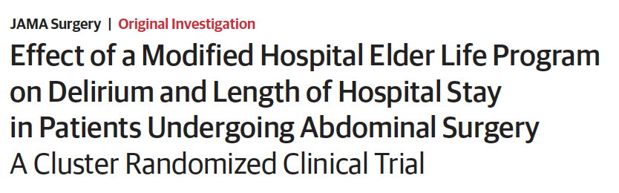
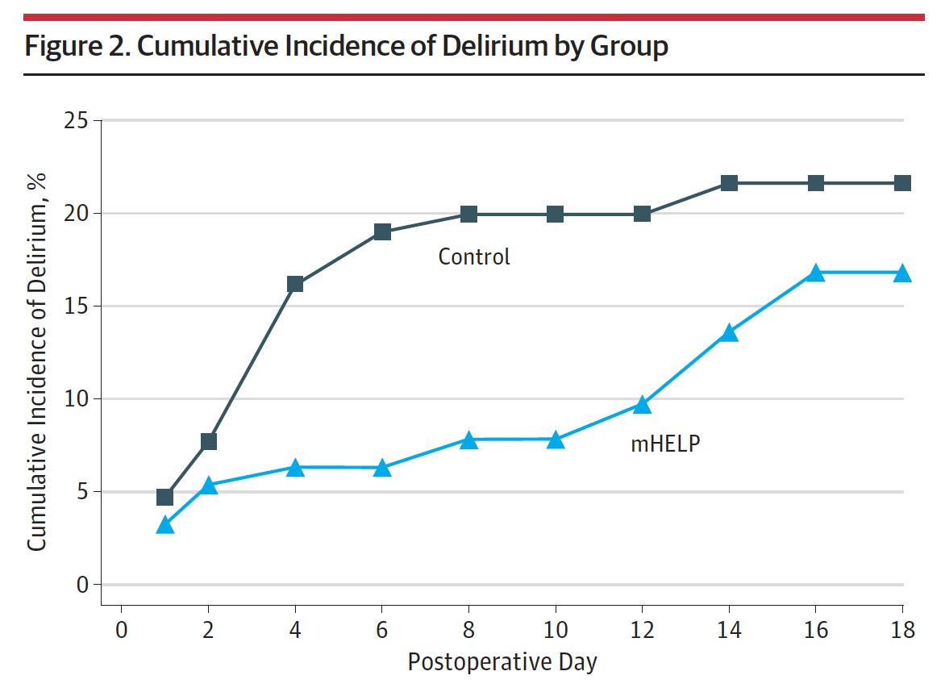
Modified HELP for Surgery
Orienting communication
Oral & nutritional assistance
Early mobilization
Reduced delirium by 56% and LOS by 2 days
Chen et al. JAMA Surg 2017;152(9):827-34
Notes:
Enrolled patients > 65 years of age for elective abdo surgery

Slide 33
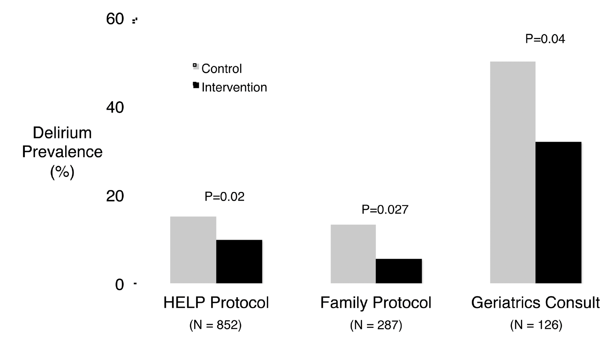
Delirium Prevention Bundles
Brummel & Girard. Crit Care Clin 2013;29(1):51-65

Slide 34
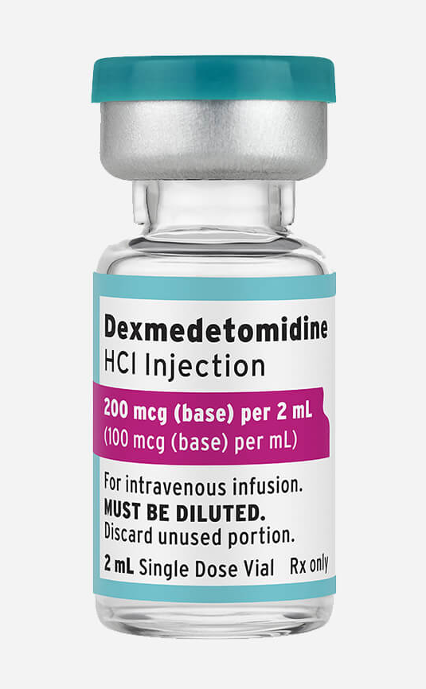
Dexmedetomidine
Central alpha-2 agonist
Prevents delirium:
  Intraoperative
  RR 0.64 95%CI 0.47 to 0.87
  Intra- & postoperative
  RR 0.54 95%CI 0.32 to 0.89
Effective in patients >65 years (not <65 years)
Increased bradycardia & hypotension
Qin et al. J Clin Anesth 2021;73:110308
Notes:
RCTs in non-cardiac surgery

Slide 35
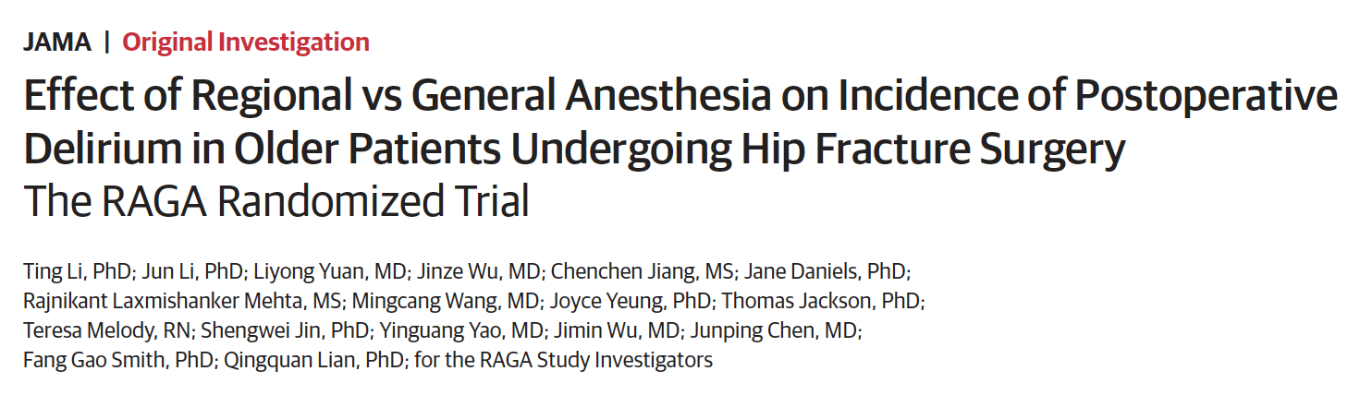
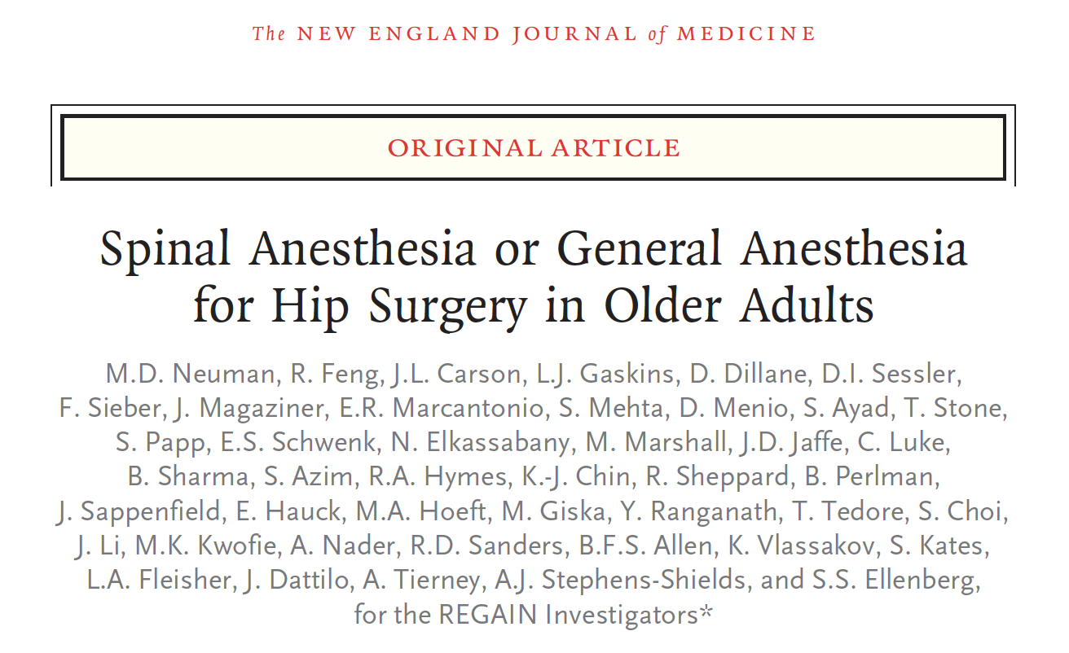
Regional vs General Anesthesia
Ting et al. JAMA 2022;327(1):50-58
Neuman et al. NEJM 2021;385(22):2025-2035

Slide 36
Regional vs GA in Hip Fracture
RAGA
REGAIN
N=950
China
Mean age 76 years
CAM
GA: 5.1%
SAB: 6.2%
N=1600
Canada & US
Mean age 78 years
3D CAM
GA 20.5%
SAB 19.7%
Ting et al. JAMA 2022;327(1):50-58
Neuman et al. NEJM 2021;385(22):2025-2035
Notes:
RAGA patients were younger, healthier, and no sedation

Slide 37
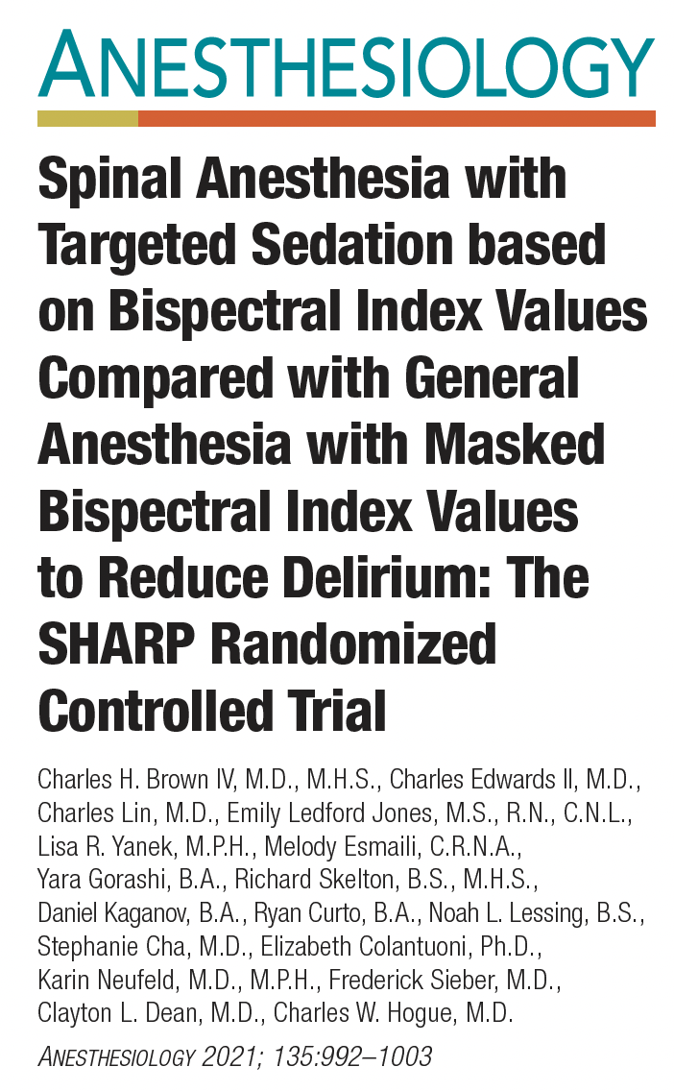
Regional vs GA
Spinal anesthesia with targeted sedation
compared with general anesthesia with masked BIS values did not reduce
delirium after lumbar fusion (25% vs 19%)
Brown et al. Anesthesiology 2021;135:992-1003

Slide 38
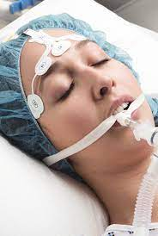
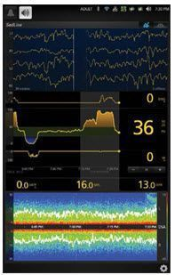
Depth of Anesthesia

Slide 39
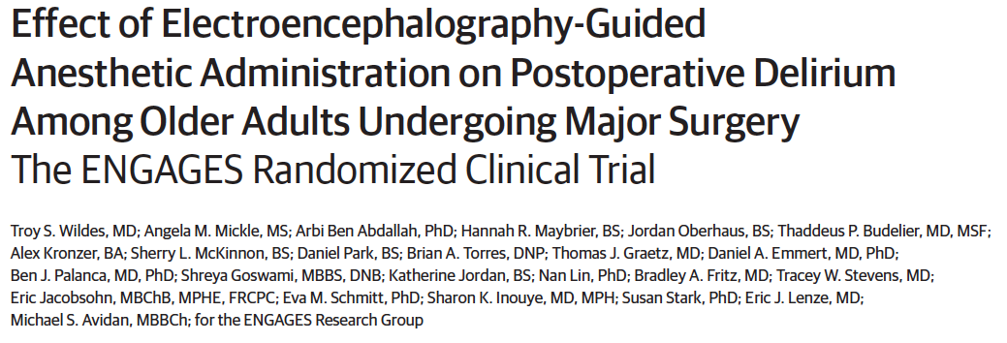

Depth of Anesthesia
ENGAGES
Delirium (POD 1-5) occurred in 26% of the EEG-guided group and 23% of the usual care group
Wildes et al. JAMA 2019; 321: 473-483
Notes:
Limitations: usual care (ambiguous) and didn’t achieve good separation between the two groups in terms of MAC

Slide 40

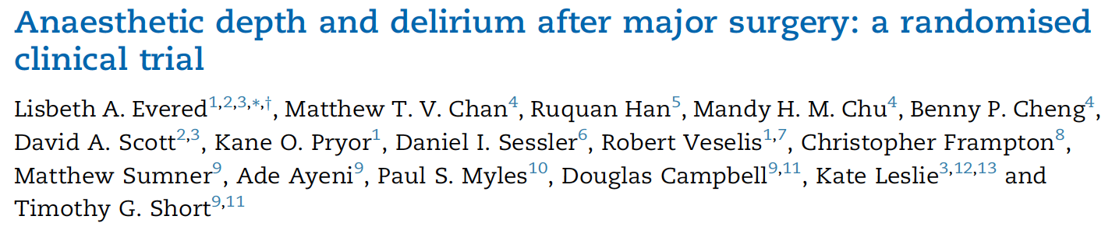
Depth of Anesthesia
Sub-study of BALANCE Randomized Trial
BIS Target 50 (vs 35) was associated with a lower incidence of POD: 19% vs 28% (p=0.01) and better cognitive function at 1 year
Evered et al. BJA 2021;127;667-71

Slide 41
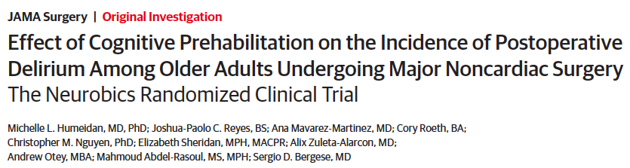

Cognitive Prehabilitation
Control 23.0% vs intervention 14.4% (P=0.08)
Removed 4 who did not attempt cognitive exercise:
Delirium 13.2% (P=0.04)
Humeldan et al. JAMA Surg. 2021;156(2):148-156

Slide 42
Management of Delirium
Identify Reversible Causes
Non-Pharmacological Approaches
Pharmacological Intervention
Re-orientation & de-escalation techniques
Low dose anti-psychotic (e.g. haloperidol, loxapine) – off label
Dexmedetomidine (PACU) – off label
Drugs: remove (benzo, sleep aids) or add (melatonin)
Correct electrolytes, dehydration, treat pain
Treat underlying conditions, sleep hygiene
Family/friend visits, vision/hearing aids
Marcantonio NEJM 2017;277:I456-66
Notes:
Avoid restraints if possible

Slide 43
Bedford’s Conclusions
Operations on elderly people should be confined to unequivocally necessary cases
Pre-medications and postoperative medications should not be a routine matter
During and after operation under anesthesia, it is important that the blood pressure, hemoglobin concentration and oxygenation of the blood should be kept at optimal levels
Bedford. Lancet 1955; 266: 259-264
Notes:
note: old people = at or over the age of 50!

Slide 44
Summary
Identify & disclose risks to patients/families
Baseline neurocognitive testing for at-risk patients
Avoid benzodiazepines and precipitants in at-risk patients
Screen high risk patients for delirium postoperatively (3D-CAM or 4AT)
Delirium prevention bundles are very effective
Depth of anesthesia remains under investigation
Future research: dexmedetomidine, cognitive prehabilitation
Ideal management of delirium is not well-defined
Mode of anesthesia does not appear impactful

Slide 45



Brain Health Pathway: Delirium
Preoperative
Intraoperative
Postoperative
Identification of high-risk patients
Education Tools
Family Involvement
Cognitive prehab?
Dexmedetomidine
GA = regional
Depth of anesthesia?
Delirium screening (CAM) Delirium prevention bundles
Delirium management

Slide 46
Thank you
aflexman@providencehealth.bc.ca

